Slide 1

CS-310 Scalable Software Architectures
Lecture 9:
SQL Database Scaling
Steve Tarzia

Slide 2
Recap: Storage and Relational Databases
Persistent storage requires special consideration due to slow performance and lack of language-level support.
  RAID combines multiple disks for better capacity, storage, and fault tolerance.
Databases solve lots of problems:
  scalability, persistence, indexing, concurrency, etc.
  Filesystems can solve some, but not all, of these problems.
Relational (SQL) databases store data in tables.
Developer defines the DB schema first (tables, columns, keys).
  Rows are added during DB operation, and they must fit the schema.
Indexes let us find rows quickly with value of one or more column.
SQL query language lets us run analysis code "close to" data storage (filtering, aggregation – sum, count, min, max, avg, etc.).

Slide 3

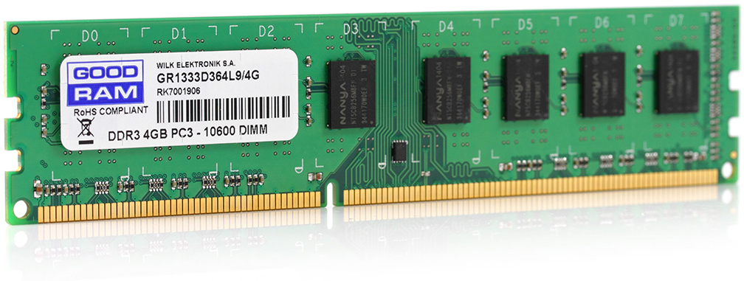
Memory vs disk access in databases
Remember that computers have a hierarchy of storage.
RAM is 100,000x faster but ~100x smaller than disk.
Database servers operate much faster when accessing data that is cached in RAM (memory).
  RAM can be up to ~1TB.
A subset of data is cached in RAM
One big computer
Disk access I/O
The remainder of data is on disk
(up to petabytes!)
Goal: fit entire active data set in RAM.
Database/OS automatically cache most frequent data in RAM.

Slide 4
Databases are performance bottlenecks
Request
Why is load balancer not the bottleneck in this design?
  Load balancer does much less work per request than the database.
Why not create clones of the database?
  Traditional scalable service design relies on a single shared database for coordination. App clones share state through the database.
  However, we'll learn some tricks in this lecture.
STOP
and
THINK
Load Balancer
App
App
App
App
App clones
STOP
and
THINK
Shared Database

Slide 5
Relational Database performance optimizations
Query planners optimize order of table access and use of indexes:
    SELECT * FROM user NATURAL JOIN post
    WHERE post.date > "2010-01-01" AND user.birth_year < 1920;
RAM is used to store the most important data and indexes.
Responses can be cached and replayed if data has not changed.
To avoid a database bottleneck:
Avoid unnecessary queries (cache data in the frontend).
Buy a really fast machine, with plenty of RAM for caching.
Use the fastest possible disks (SSDs, RAID).
Use read replicas or sharding – Horizontal Scaling
STOP
and
THINK
Vertical
Scaling

Slide 6
Read replicas
Often, > 95% of DB traffic is reads.
Replica servers each have a full copy of all the data, and they can handle read requests (SELECT).
All writes (UPDATE, DELETE) must go to the Primary server (a.k.a. Main, Master)
Data changes are pushed to read replicas.
However, replicas may be slightly behind the primary, so read requests that are sensitive to consistency should use the primary.
Too many replicas would make the data push process a bottleneck in the primary.

Slide 7
What limits the number of read replicas?
STOP
and
THINK
This design is not infinitely scalable.
The Primary is a central bottleneck and single point of failure.
If there are N replicas, Primary must send N copies of each write.
If there are R times as many reads as writes, and we want to equalize load on Primary and Replicas (to the max machine capacity), we get:
  primary_load = repl_load
  primary_reads + primary_writes + data_xfer = repl_reads + repl_writes + data_xfer
  0 + 1 + N = R + 0 + 1
  N = R
Here, the optimal number of replicas is directly proportional to the ratio of reads to writes, perhaps about ten in a typical application.
STOP
and
THINK
Ideas for greater scaling of reads?

Slide 8
Multi-level replication can extend read-scalability
Where do read requests go? 🛑
  To the bottom level replicas.
  (nine are shown in this diagram)
Why not read from middle replicas? 🛑
  Like the primary, they are busy pushing writes to their many children.
Where do write requests go? 🛑
  To the one primary.
Can we add more replication levels
(to achieve arbitrary width)? 🛑
  Yes, but each level adds more delay between write at primary and data availability at read replicas.
Primary
Middle Replica
Middle Replica
Middle Replica
R
R
R
R
R
R
R
R
R
This is a kind of horizontal scaling for database reads.

Slide 9
How to use read-replicas?
Put a load balancer in front of all the read replicas.
This can be a NAT-type local LB or a simple software library. (eg.)
INSERT
UPDATE
DELETE
App
App
App
SELECT
SQL Writes
SQL Reads
Primary
Load Balancer
R
R
R
R
R
R
R
R
R

Slide 10
Replication shortcomings?
STOP
and
THINK
INSERT
UPDATE
DELETE
App
App
App
SELECT
SQL Writes
SQL Reads
Primary
Load Balancer
R
R
R
R
R
R
R
R
R
Writes are not scalable. They are all handled by one DB machine.
Capacity is not scalable. All the data must fit on each DB machine.
Primary is a single point of failure.

Slide 11
Primary-primary failover for robustness
Keep a "standby" primary ready to take over if the main primary fails.
App will switch over to Standby if the main primary stops responding.
Normal
After Failure
App
App
App
App
App
App
Load Balancer
Primary
Standby Primary
Dead Primary
Standby Primary
Load Balancer
R
R
R
R
R
R
R
R
R
R
R
R

Slide 12
Why not allow writes to multiple primarys?
STOP
and
THINK
App
App
App
Writes
Primary1
Primary2
Each Primary still must handle all the writes, though indirectly.
Thus, the same performance bottleneck remains.
Also, data can become inconsistent if operations happen concurrently.

Slide 13
How to scale writes and storage capacity?
We already tried vertical scaling.
How to implement horizontal scaling of a writes and capacity?
Some kind of partitioning is needed:
Functional partitioning:
  Create multiple databases storing different categories/types of data.
  Eg.: three separate databases for: accounts, orders, and customers.
  Cons:
    Limits queries joining rows in tables in different DBs
    Only a few functional partitions are possible. It's not highly scalable.
Data partitioning is a more general approach…
STOP
and
THINK
Functional partitioning divides by tables
Data partitioning divides by rows

Slide 14
Sharding (data partitioning) relational databases
Divide your data universe into disjoint subsets is called shards.
For example: Consider parallelizing Facebook's database…
  Maybe put Illinois users in one machine, Wisconsin in another, etc.
  Each node stores rows for all tables, but only a subset of rows.
Sharding key determines assignment of rows to shards.
Relational databases usually don't support sharding natively, it must be somehow hacked at the application level.
Shard1
Illinois data
Shard2
Wisconsin data
Shard3
New York data
…

Slide 15
Sharding example
Shard0
Shard1
User
Post
User
Post
user | name
0 | Steve
2 | Yingyi
4 | Alex
user | date | text
0 | 04-25 | Hi there…
0 | 04-27 | Still tea…
2 | 03-12 | Web scal…
2 | 04-25 | Tips and…
user | name
1 | Guannan
3 | Clarissa
user | date | text
3 | 04-05 | Box pl…
1 | 04-27 | Sound…
1 | 03-12 | Random…
3 | 04-27 | Northw…
All the data we need must be on Shard 0.
In this example, shard_id = user % 2
How to implement query for all posts by Steve?
SELECT * FROM Post NATURAL JOIN User WHERE user=0?

Slide 16
Sharding example 2
Shard0
How to implement query for latest 10 posts from Steve's friends?
SELECT * FROM User
NATURAL JOIN Friend
JOIN Post ON
Post.user=
Friend.friend
WHERE User.name="Steve" ORDER BY date DESC LIMIT 10;
Friend
User
Post
user | friend
0 | 1
0 | 2
0 | 3
0 | 4
6 | 0
user | name
0 | Steve
2 | Yingyi
4 | Alex
user | date | text
0 | 04-25 | Hi there…
0 | 04-27 | Still tea…
2 | 03-12 | Web scal…
2 | 04-25 | Tips and…
STOP
and
THINK
Steve may be friends with users in all the shards; all shards must be queried.
Query above will not work verbatim: user=0 row only exists in Shard0.
Each shard can supply ten latest posts, app must manually merge them and choose the latest ten.

Slide 17
Sharding conclusions
Pros
Cons
Because each row is stored once:
Capacity scales.
Data is consistent.
If sharding key is chosen carefully:
Data will be balanced.
Many queries will involve only one or a few shards. There is no central bottleneck for these.
Cannot use plain SQL.
Queries must be manually adapted to match sharding.
If sharding key is chosen poorly, shard load will be imbalanced, either by capacity or traffic.
Some queries will involve all the shards. The capacity for handling such queries is limited by each single machine's speed.

Slide 18
Some Simple Scaling math
N nodes
R total request rate (requests per second or another time frame)
Each node has the capacity to handle a maximum rate of requests C.
If each request is sent to one node:
  R_{max} = NC
If each request is sent to a
constant k number of nodes:
  R_{max} = NC/k = 𝒪(NC)
If each request is sent to all nodes:
  R_{max} = C
Scalable (increases with N)
Not Scalable

Slide 19
Summary
Read replicas horizontally scale databases for reading.
  Writes are done in one place and propagated to many replicas.
  Data on a given replica may lag behind primary, but it's self-consistent.
  Works well if writes are much less common than reads.
Horizontal scaling of writes suggests data partitioning.
  Each data row/element is assigned a single "home"
  If not, consistency is very tricky (write race conditions for transactions).
Sharding is data partitioning for SQL/relational DBs.
  Works well for queries that can be handled within a single shard.
  Sharding divides data along just one dimension, so inevitably some queries will involve all the nodes, and thus will not be scalable.
Next time… NoSQL databases for more horizontal scaling!

