Slide 1

EECS-317 Data Management and Information Processing
Lecture 9 – Midterm Review
Steve Tarzia
Spring 2019

Slide 2
Announcements
Midterm is next class (Thurs May 2nd)
  Covers SQL queries.
    Lectures 1-6
    All homeworks
  Open book, open notes, but you cannot share any materials.
  Seats will be assigned.
  Ten page practice exam (with answers) is posted.
  Last year’s midterm (with answers) is also posted.
  Don’t forget to do the practice homeworks in Canvas.

Slide 3
Why use a relational database?
Scalability – work with data larger than computer’s RAM
Persistence – keep data around after your program finishes
Indexing – efficiently sort & search along various dimensions
Integrity – restrict data type, disallow duplicate entries
Deduplication – save space, keep common data consistent
Concurrency – multiple users or applications can read/write
Security – different users can have access to specific data
“Researchability” – SQL allows you to concisely express analysis

Slide 4
Sometimes we start with one redundant table and break it down to reflect the logical components
staff
id | name | department | building | room | faxNumber
11 | Bob | Industrial Eng. | Tech | 100 | 1-1000
20 | Betsy | Computer Sci. | Ford | 100 | 1-5003
21 | Fran | Industrial Eng. | Tech | 101 | 1-1000
22 | Frank | Chemistry | Tech | 102 | 1-1000
35 | Sarah | Physics | Mudd | 200 | 1-2005
40 | Sam | Materials Sci. | Cook | 10 | 1-3004
54 | Pat | Computer Sci. | Ford | 102 | 1-5003

Slide 5
This is called Normalization
staff
id | name | department
11 | Bob | 1
20 | Betsy | 2
21 | Fran | 1
22 | Frank | 4
35 | Sarah | 5
40 | Sam | 7
54 | Pat | 2
department
id | name | building
1 | Industrial Eng. | 1
2 | Computer Sci. | 2
4 | Chemistry | 1
5 | Physics | 4
7 | Materials Sci. | 5
building
id | name | faxNumber
1 | Tech | 1-1000
2 | Ford | 1-5003
4 | Mudd | 1-2005
5 | Cook | 1-3004
6 | Garage | 1-6001
Removes redundancy
  Save space
  Edit values in one place, so duplicates don’t become inconsistent
Tables can be populated separately
But, you are adding a new id column for each table

Slide 6
Tables
Represent objects, events, or relationships
  Each of its rows must be uniquely identifiable
  Has attributes that the DB will store in columns
  Can refer to rows in other tables
Objects: people, places, or things
Events: usually associated with a specific time. Can recur.
Relationships: associations
Designing a set of tables is called data modelling, and it’s best learned by example.

Slide 7
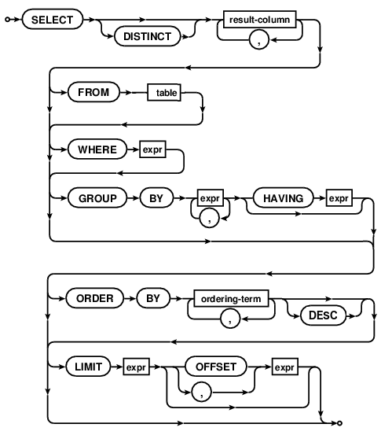
Basic SELECT Syntax
“table” can be:
A single table
Multiple tables JOINed together
A subquery that returns a table

Slide 8
SELECT steps (abbreviated)
FROM chooses the table of interest
WHERE throws out irrelevant rows
GROUP BY identifies rows to combine
SELECT tells what values to return (allowing math and aggregation)
HAVING throws out irrelevant rows (after aggregation)
ORDER BY sorts
LIMIT throws out rows based on their position in the results
Each step gets closer to the specific result you want.

Slide 9
Integer vs. floating point division
Computers store numbers in two basic ways:
  Integers are whole numbers (0, 3, -40,921)
  Floating Point numbers (floats) can be fractional (1.234, 0.0, -9.9×10⁻⁴)
When doing arithmetic on two integers, an integer is always produced.
  1+1 = 2, 2-1=1, 4*3=12, 13/4=3
When doing arithmetic involving at least one float, a float is produced.
  1.0 + 1.0 = 2.0, 1.5 * 2 = 3.0, 13/4.0=3.25
Integer division is weird – it always rounds down: 2/3 = 0, -5/2 = -3
Usually you need floating-point (not integer) division in your queries.
  Just precede the expression with a floating point operation to force the division to be floating point: 1.0 * -5 / 2 = -2.5

Slide 10
Aggregation functions
COUNT, SUM, MIN, MAX, AVG
These can be used to print out values that depend on multiple rows.
For example, how many ounces of ingredients are used?
  We have to add up the “Amount” from many rows to get this answer:
  SELECT SUM(Amount) FROM Recipe_Ingredients
  WHERE MeasureAmountID=1;
  (“ounce” corresponds to MeasureAmountID=1)
GROUP BY causes aggregations to occur on subsets of rows, where rows are grouped according to some rule.
  Each group contains rows having the same value for the grouping expression
  SELECT SUM(Amount) FROM Recipe_Ingredients
  GROUP BY MeasureAmountID;
  Same as above, but list amounts of all ingredients

Slide 11
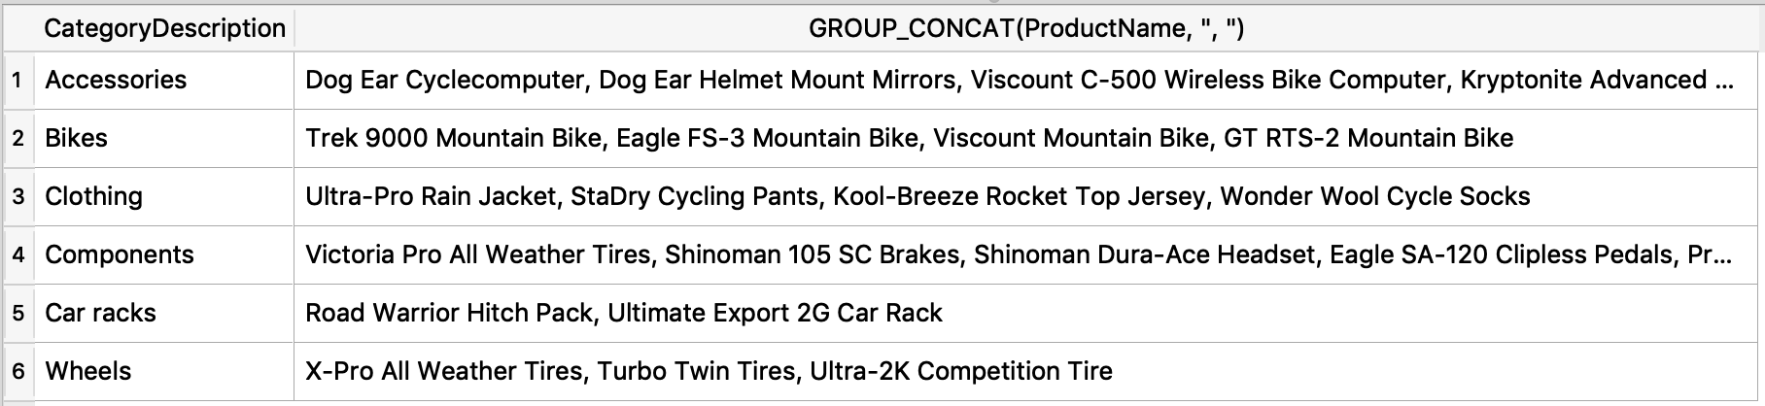
GROUP_CONCAT() is another aggregator
Concatenates non-null values, optionally with a separator string.
Eg.: Print all the products in each category
SELECT CategoryDescription, GROUP_CONCAT(ProductName, ", ")
FROM Products NATURAL JOIN Categories GROUP BY CategoryID;

Slide 12
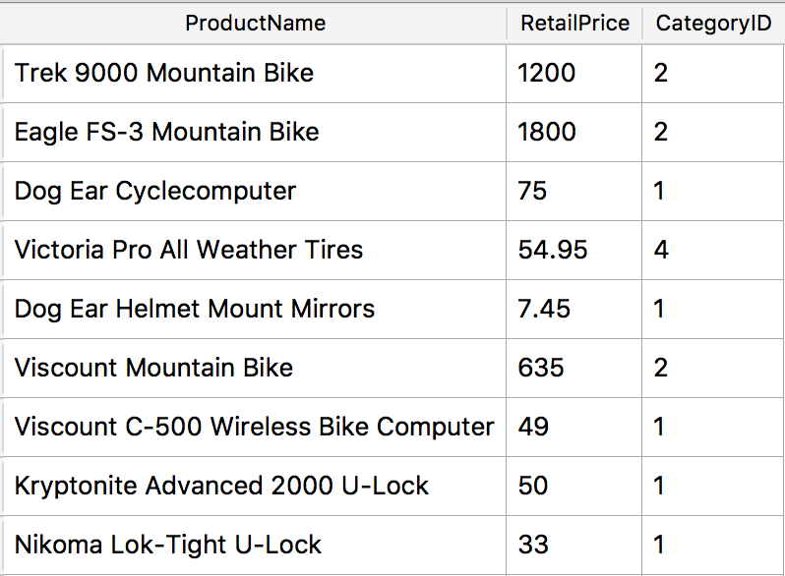
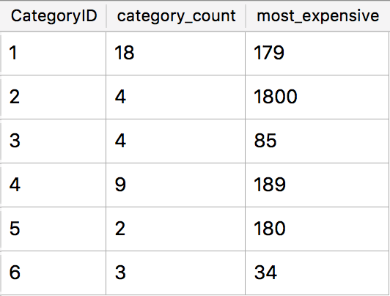
GROUP BY explained
GROUP BY combines multiple rows into one row in the result.
Rows with the same value for the grouping criterion are grouped.
An aggregation function is usually applied.
SELECT CategoryID, COUNT(*) AS category_count,
MAX(RetailPrice) AS most_expensive_price
FROM Products GROUP BY CategoryID;
Notes:
Number of rows in the result will equal the number of unique values taken by the grouping criterion.

Slide 13
Subqueries
Any single value, list of values, or table can be replaced by a subquery
A subquery is a query that appears inside of parentheses.
  The subquery is computed first and its result is “plugged into” the parent expression.
  SELECT SUM(Amount) FROM Recipe_Ingredients
  WHERE MeasureAmountID=
  (SELECT MeasureAmountID FROM Measurements
  WHERE MeasurementDescription="Ounce");

Slide 14
INNER JOIN review
staff
id | name | room | departmentId
11 | Bob | 100 | 1
20 | Betsy | 100 | 2
21 | Fran | 101 | 1
department
id | name | buildingId
1 | Industrial Eng. | 1
2 | Computer Sci. | 2
4 | Chemistry | 1
1 | Physics | 4
1 | Materials Sci. | 5
In output,
multiple matches leads to multiple rows.
no matches leads to no rows
SELECT * FROM staff JOIN department ON staff.departmentId=department.id
staff.id | staff.name | staff.room | staff.departmentId | department.id | department.name | department.buildingId
11 | Bob | 100 | 1 | 1 | Industrial Eng. | 1
11 | Bob | 100 | 1 | 1 | Physics | 4
11 | Bob | 100 | 1 | 1 | Materials Sci. | 5
20 | Betsy | 100 | 2 | 2 | Computer Sci. | 2
21 | Fran | 101 | 1 | 1 | Industrial Eng. | 1
21 | Fran | 101 | 1 | 1 | Physics | 4
21 | Fran | 101 | 1 | 1 | Materials Sci. | 5

Slide 15
NATURAL JOIN
A shorthand notation to make some JOINs shorter to express.
NATURAL JOIN matches rows using whatever columns have identical names.
For example:
  SELECT * FROM Orders JOIN Order_Details
  ON Orders.OrderNumber=Order_Details.OrderNumber;
Becomes:
  SELECT * FROM Orders NATURAL JOIN Order_Details;

Slide 16
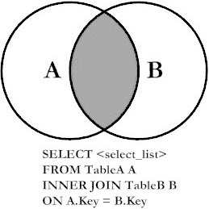
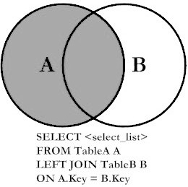
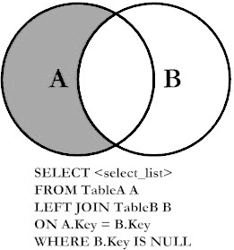
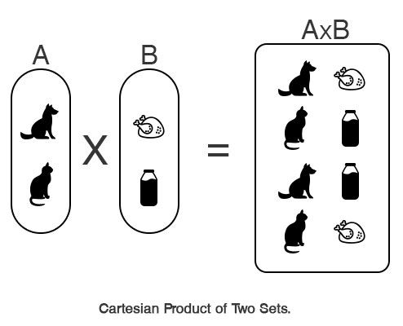
Outer and Cross Joins
Introduced different types of JOINs:
INNER (default): prints all pairs of rows (one from first table, one from second table) that satisfy the JOIN predicate.
LEFT: same as INNER, but adds rows from LEFT table that never satisfied the JOIN predicate.
LEFT with exclusion: only print rows from left table that never satisfied the JOIN predicate.
CROSS JOIN: print the cartesian project, meaning all rows from the first table combined with all rows from the second table. There is no “ON” to match rows.

Slide 17
SELECT * FROM staff LEFT JOIN department ON staff.departmentId=department.id;
staff
id | name | room | departmentId
11 | Bob | 100 | 1
20 | Betsy | 100 | NULL
21 | Fran | 101 | 1
22 | Frank | 102 | 99999
35 | Sarah | 200 | 5
40 | Sam | 10 | 7
54 | Pat | 102 | 2
department
id | name | buildingId
1 | Industrial Eng. | 1
2 | Computer Sci. | 2
5 | Physics | 4
7 | Materials Sci. | 5
Betsy and Frank have NULLs in the right haft of the output because no matching department was found.
In other words no pair of rows was found to satisfy the ON staff.departmentId=department.id
staff.id | staff.name | staff.room | staff.departmentId | department.id | department.name | department.buildingId
11 | Bob | 100 | 1 | 1 | Industrial Eng. | 1
20 | Betsy | 100 | NULL | NULL | NULL | NULL
21 | Fran | 101 | 1 | 1 | Industrial Eng. | 1
22 | Frank | 102 | 99999 | NULL | NULL | NULL
35 | Sarah | 200 | 5 | 5 | Physics | 4
40 | Sam | 10 | 7 | 7 | Materials Sci. | 5
54 | Pat | 102 | 2 | 2 | Computer Sci. | 2

Slide 18
LEFT JOIN with Grouping
When computing an aggregation on a many-to-one relationship, LEFT JOIN includes rows from the parent table with no children.
In ClassScheduling.slite, count the classes taught by each faculty member:
  If you want this report to include faculty members teaching zero classes, you must use LEFT JOIN:
  SELECT StaffID, ClassID,
  COUNT(ClassID) AS num_classes
  FROM Faculty NATURAL LEFT JOIN Faculty_Classes
  GROUP BY StaffID;
  Note that “COUNT(*)” would return “1” for faculty members with no classes, because there would still be one unmatched row from the left table.

Slide 19
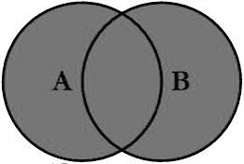
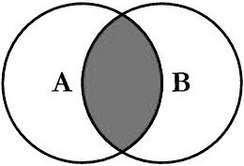
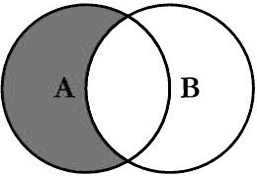
UNION, INTERSECT, and EXCEPT are used to combine two SELECT statements
UNION prints rows from either of two SELECTs
(printing duplicates just once)
INTERSECT prints rows present in both SELECTs
EXCEPT prints rows present in one SELECT but missing from another SELECT

Slide 20
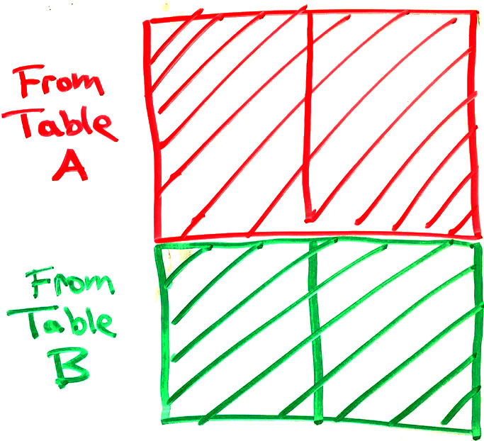
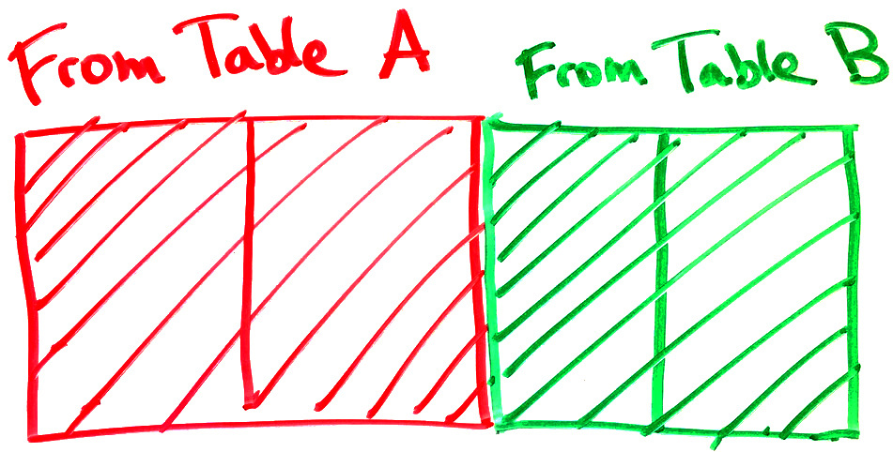
JOIN vs. UNION
JOINs combine tables horizontally.
  Match rows from two tables based on one or more columns matching.
  Creates a wider set of rows, adding columns from both tables.
JOIN:
  UNION, INTERSECT, and EXCEPT combine result tables vertically
  Number & type of columns in the two result tables must match
  Changes the number of rows,
  not columns
UNION:

Slide 21
Summing an indicator variable
Two ways to count recipes with “salsa” in description:
SELECT COUNT(*) FROM Recipes WHERE RecipeTitle LIKE "%salsa%”;
  WHERE clause keeps just the rows matching “salsa,” then these rows are counted.
SELECT SUM(RecipeTitle LIKE "%salsa%")
FROM Recipes;
  A column is created for every recipe indicating whether its title matches “salsa” or not.
  Column’s value will be 1 if it matches and 0 if not.
  Sum of all the ones and zeros will be the count of matching recipes.
First approach is easier to understand, but second is shorter.

Slide 22
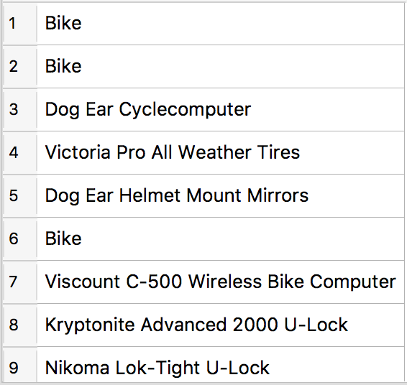
CASE gives if-then-else behavior
WHEN condition is tested for every row, giving true or false
SELECT CASE WHEN CategoryID=2
THEN "Bike"
ELSE ProductName END FROM Products;
If condition is true then use the first value.
If condition is false then use the second value.
Output:

Slide 23

If you wish to dig further into SQL

Slide 24
What’s coming in the second half of the course?
More data modeling (designing new databases)
Indexing to handle large databases
Defining databases and adding data
Numeric formats
  integers, floats, precision
  Dates and times
Text encodings
  ASCII, UTF-8, special characters
Organizing data in files (semi-structured data)
  CSV, XML, JSON
Messy data
  Missing entries, fuzzy matching
... and perhaps more, time permitting

Slide 25
HW3 Q4
﻿SELECT DISTINCT Order_Details.OrderNumber
FROM Order_Details NATURAL JOIN Products NATURAL JOIN Product_Vendors
JOIN Order_Details AS od2 ON Order_Details.OrderNumber=od2.OrderNumber
GROUP BY Order_Details.OrderNumber, VendorID
HAVING COUNT(DISTINCT Order_Details.ProductNumber)=COUNT(DISTINCT od2.ProductNumber)

Slide 26
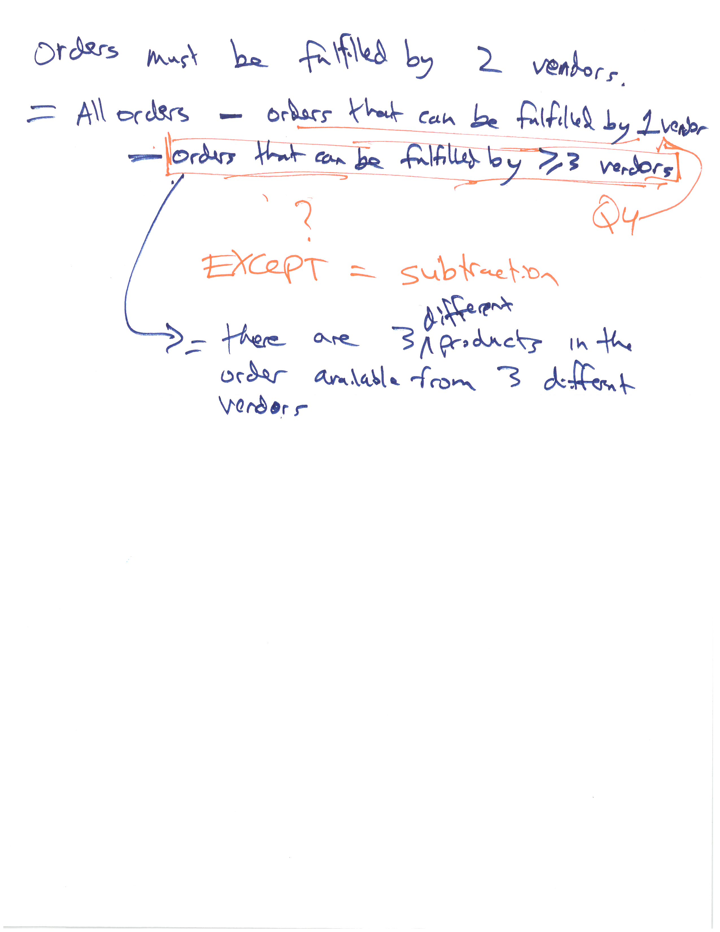
HW3 Q5 strategy

Slide 27
HW3 Q5
﻿-- Start with all orders
SELECT OrderNumber FROM Orders
EXCEPT
-- remove the orders that can be satisfied with one vendor (Q4):
SELECT DISTINCT Order_Details.OrderNumber
FROM Order_Details NATURAL JOIN Products NATURAL JOIN Product_Vendors
JOIN Order_Details AS od2 ON Order_Details.OrderNumber=od2.OrderNumber
GROUP BY Order_Details.OrderNumber, VendorID
HAVING COUNT(DISTINCT Order_Details.ProductNumber)=COUNT(DISTINCT od2.ProductNumber)
EXCEPT
-- remove the orders that have three different products available from three different vendors
SELECT o1.OrderNumber
-- list each possible combination of three line items from each order
FROM Order_Details AS o1 JOIN Order_Details AS o2 ON o1.OrderNumber=o2.OrderNumber
JOIN Order_Details AS o3 ON o3.OrderNumber=o1.OrderNumber
JOIN Product_Vendors v1 ON o1.ProductNumber=v1.ProductNumber
JOIN Product_Vendors v2 ON o2.ProductNumber=v2.ProductNumber
JOIN Product_Vendors v3 ON o3.ProductNumber=v3.ProductNumber
WHERE
-- vendors are different
v1.VendorID != v2.VendorID
AND v1.VendorID != v3.VendorID
AND v2.VendorID != v3.VendorID
-- products are different
AND o1.ProductNumber != o2.ProductNumber
AND o1.ProductNumber != o3.ProductNumber
AND o2.ProductNumber != o3.ProductNumber;

