Slide 1
CS-340 Introduction to Computer Networking
Lecture 2: The Internet core, and Layering
Steve Tarzia
Many diagrams & slides are adapted from those by J.F Kurose and K.W. Ross

Slide 2
Last Lecture
Gave a high-level view of the Internet
Various physical media and access network types are used
It’s loosely-couple and de-centralized
  Everyone’s invited to the Internet, assuming you follow the protocols and can somehow connect.
A protocol is a set of rules for communication.
Telephone network uses circuit switching (reserves end-to-end path).
Internet uses packet switching (store-and-forwarded along path)
  Delivery is “best effort,” not guaranteed.

Slide 3
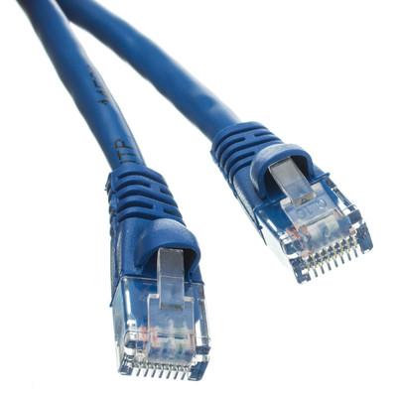
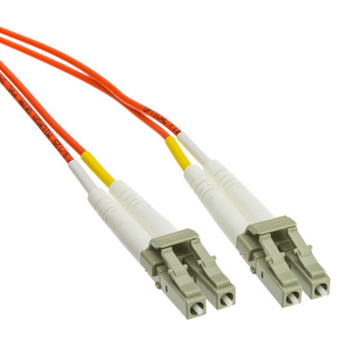

Simple Communication Link Model: tubes?
0 1 1 1 1 0 1 1 1 1 0 0 1
0 1 1 1 1 0 1 1 1 1 0 0 1 1 1 1
Chapter 6 has more detail, but for now, a communication link is:
A bi-directional, point-to-point connection (one party on each side).
Allows 0’s or 1’s to be transmitted (or it can be idle, sending nothing).
It has a propagation delay – the time it takes for bits to flow from sender to receiver (at most the speed of light!).
  This is the link latency. Often determined by the length of the link.
Operates at a certain, constant bitrate (bits per second).
  This is the link throughput. Determined by the technology of the link.

Slide 4

Circuit Switching Review
If two people wanted to talk, a dedicated electrical path (circuit) is established.
The circuit remains dedicated to the call until the parties hang up.
Physical links in the of the network are divided into several virtual channels and thus can be shared by a finite number of users.
2 of 4 channels are being used on this one physical link
Time division multiplexing (TDM)
4 users:
time

Slide 5



Packet-switching uses “store and forward”
L bits
per packet
3
2
1
source
destination
R bps
R bps
In any network, data takes several hops (steps) to reach destination.
In packet switching, each intermediate router has a queue of packets waiting to be sent along the next hop. Unlike circuit switching, there is no reserved capacity (time slot) for the data to be sent. Instead send packets in FIFO order. This is a more dynamic way to share the link!

Slide 6










Routers form the network core
Routers have two responsibilities:
Distributed routing algorithms to determine which address ranges are most quickly reachable on each of its outbound links.
Packet forwarding, to direct packets according to the decisions made above.

Slide 7
Queueing delay and loss
C
A
R = 100 Mb/s
D
R = 1.5 Mb/s
B
E
queue of packets
waiting for output link
Packets arriving at a router are placed on a finite-sized queue.
  Waiting in the queue introduces delay
  If the queue is full, new packets are dropped
    Remember that packet delivery is not guaranteed on the Internet.

Slide 8
Four sources of packet delay
transmission
A
propagation
B
nodal
processing
queueing
d_{nodal} = d_{proc} + d_{queue} + d_{trans} + d_{prop}
d_{proc}: nodal processing delay
check bit errors
choose output link
typically < msec
d_{queue}: queueing delay
time waiting at output link for transmission
depends on congestion level of the outbound link

Slide 9
Four sources of packet delay
transmission
A
propagation
B
nodal
processing
queueing
d_{nodal} = d_{proc} + d_{queue} + d_{trans} + d_{prop}
d_{trans}: transmission delay
= packet size (bits)
/ link bandwidth (bps)
d_{prop}: propagation delay
≅ length of the link
/ speed of light (~2x10⁸ m/s)

Slide 10
The Internet is a network of networks
We know that each local area will have its own telephone and cable companies, universities, etc. How should we connect all these local ISPs?
…
…
STOP
and
THINK
access
net
access
net
access
net
access
net
access
net
access
net
access
net
…
…
access
net
access
net
access
net
access
net
access
net
…
access
net
access
net
access
net
…
access
net

Slide 11
Idea 1: Connect them pairwise?
But this would require N² connections, and very long connections!
…
…
access
net
access
net
access
net
…
…
access
net
access
net
access
net
access
net
…
…
…
…
access
net
access
net
access
net
access
net
access
net
…
…
access
net
access
net
access
net
…
access
net

Slide 12
Idea 2: A global “Tier 1” ISP
An ISP for ISPs, with a few long and fast connections
…
…
access
net
access
net
access
net
access
net
access
net
access
net
access
net
…
…
global
ISP
access
net
access
net
access
net
access
net
access
net
…
access
net
access
net
access
net
…
access
net

Slide 13
Idea 3: Multiple Tier 1 ISPs
Multiple Tier 1 ISPs will arise to compete for business and to operate in different continents.
…
…
access
net
access
net
access
net
access
net
access
net
access
net
access
net
ISP A
…
…
access
net
ISP B
access
net
ISP C
access
net
access
net
access
net
access
net
…
access
net
access
net
…
access
net

Slide 14
Tier 1 ISPs must be interconnected
If your network is big & fast enough, you don’t pay others for an Internet connection. You are the Internet (or at least a big chunk of it).
ISP interconnection is often “settlement-free” (no money is exchanged).
Internet exchange point
…
…
access
net
access
net
access
net
access
net
access
net
IXP
access
net
access
net
ISP A
…
…
IXP
access
net
access
net
ISP B
ISP C
access
net
access
net
peering link
access
net
access
net
…
access
net
access
net
…
access
net

Slide 15
Final version: add regional ISPs and Content Providers
Google, AWS, Akamai, and other big content providers build their own global networks, much like ISPs, to speed access to their data centers.
…
…
access
net
access
net
access
net
access
net
access
net
IXP
access
net
access
net
ISP A
…
…
Content provider network
IXP
access
net
ISP B
access
net
ISP B
access
net
access
net
access
net
regional net
access
net
…
access
net
access
net
…
access
net

Slide 16
Internet’s structure
Tier 1 ISP
Tier 1 ISP
Google
…
IXP
IXP
IXP
Regional ISP
Regional ISP
access
ISP
access
ISP
access
ISP
access
ISP
access
ISP
access
ISP
access
ISP
access
ISP
At the center are a few well-connected, large networks
Tier-1 commercial ISPs (e.g., Century Link, Verizon, AT&T, China Telecom), national & international coverage
Content provider networks (e.g, Google, Amazon): private network that connects its distributed data centers and connect to various ISPs.

Slide 17
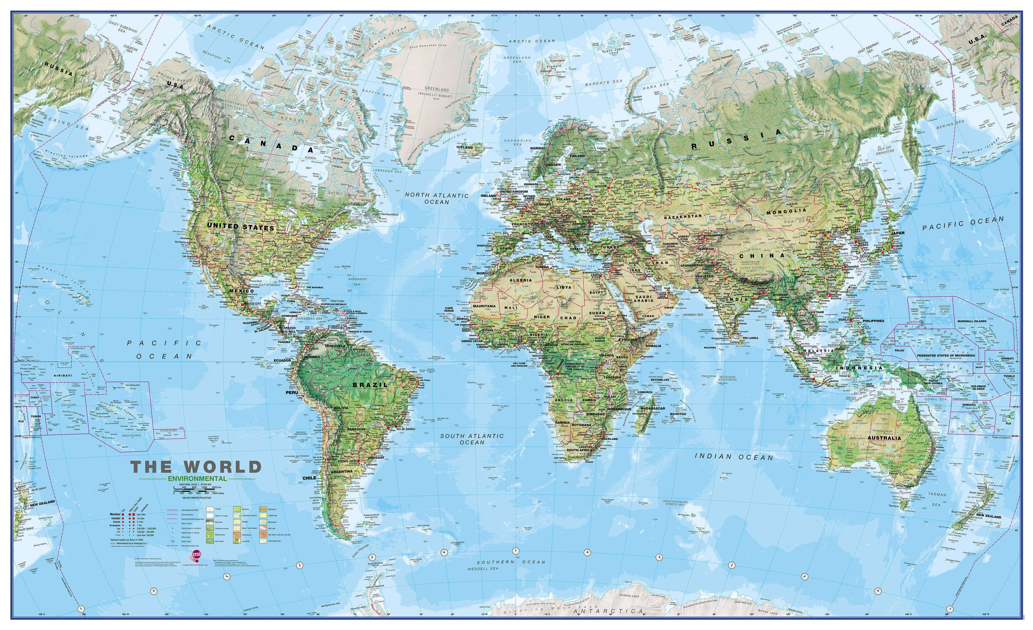
How the Internet grows and improves
How about a Tokyo-Sydney link?
STOP
and
THINK
Building a new link between San Francisco and Miami would be helpful.
ISPs operating in Miami will be very happy to let you connect for free (peer) because you’re offering a shorter route to San Francisco and all of Asia & South America. ISPs operating in San Francisco will be less enthusiastic about peering because you’re just offering faster access to Miami and Atlanta.
How about a Johannesburg-Antarctica link?

Slide 18
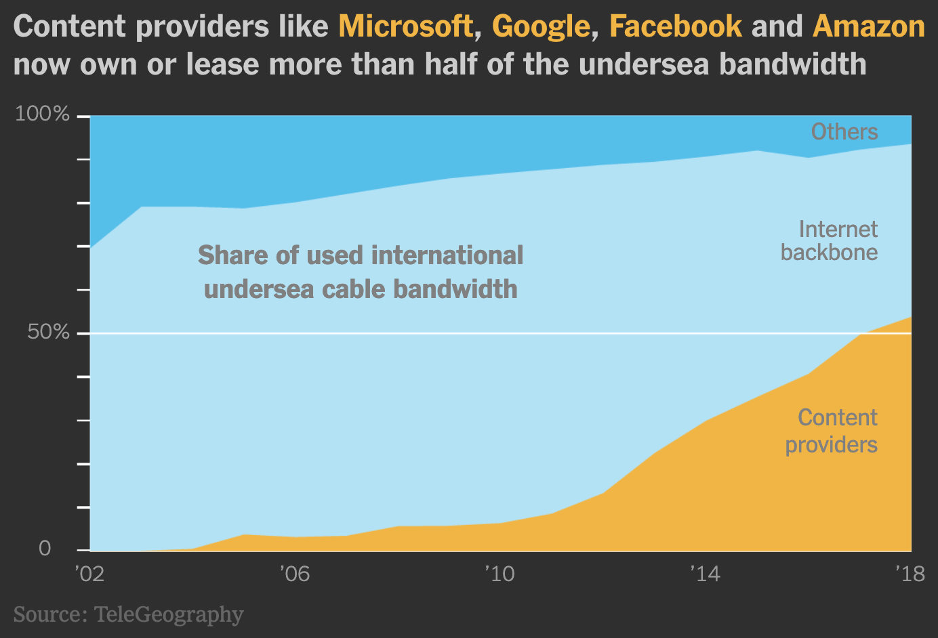
Visualization of undersea Internet cables
https://www.nytimes.com/interactive/2019/03/10/technology/internet-cables-oceans.html
https://www.submarinecablemap.com/
https://www2.telegeography.com/submarine-cable-faqs-frequently-asked-questions

Slide 19
Intermission

Slide 20
Network layers typically involved in the WWW
Networking involved many different protocols with different jobs:
HTTP – get web pages, images, etc. and post data to servers
  Handles URLs, redirects, caching, proxies, cookies
TLS – encrypt traffic (optional, but nowadays almost universal)
TCP – byte streams (ordering, delivery confirmation, pacing)
  Gives a file-like interface to network connections (read and write byte[])
  Handles limited packet size, dropped & reordered packets.
IP – forward packets across multiple hops
  Makes best-effort attempt to route packets to their destination IP address
Ethernet/Wifi – share a communication link with multiple local devices.

Slide 21
Layers add additional header bytes to packets
Ethernet Packet
MAC addresses, CRC, etc.
Ethernet payload
Ethernet Packet
MAC addresses, CRC, etc.
IP Packet
IP addresses, TTL, etc.
IP payload
IP Packet
IP addresses, TTL, etc.
TCP Packet
Port #, sequence #, ack #, etc.
TCP payload
TCP Packet
Port #, sequence #, ack #, etc.
TCP payload continued
HTTP Response
url, content-type, date, etc.
<html><body><h1>My great page</h1><p>…
HTTP Response Continued
…and that is all</p> </body></html>

Slide 22
Wireshark demo
It’s a tool for observing network traffic.

Slide 23
Sockets
Each computer on the Internet has a unique IP address.
However, a machine may have many processes running, each with its own, separate network connections.
  How do we know if an arriving packet is for Chrome or for WhatsApp?
Each TCP or UDP packet has a 16-bit port number
The OS manages ports: only one process may “listen” on a given port.
Publicly-reachable services (applications) run on standard ports:
  HTTP uses port 80
  HTTPS (with TLS encryption) uses port 443
  SMTP (email transport) uses port 25
  DNS uses port 53

Slide 24
Can we run multiple web servers on one machine?
A webserver is a process that responds to HTTP requests.
Normally we cannot run more than one, because HTTP uses port 80, and the OS will only allow one process to listen to port 80.
However, if necessary, we can run multiple webservers on a non-standard ports, and tell clients of the special port number. Eg.:
  http://murphy.wot.eecs.northwestern.edu (connects to standard port 80)
  http://murphy.wot.eecs.northwestern.edu:8000 (connects to port 8000)
  http://murphy.wot.eecs.northwestern.edu:8001 (another student can run this)
  http://murphy.wot.eecs.northwestern.edu:8002 (yet another process here)
Note that HTTPS uses a different port:
  https://murphy.wot.eecs.northwestern.edu (connects to standard port 443)

Slide 25
How do we run multiple web browsers on one host?
Let’s say we have opened multiple tabs in Chrome and Firefox.
How does a given HTTP response get directed to the correct tab?
Client can use different source ports for each outbound connection:
Outbound:
Inbound:
Client | Source IP | Source Port | Destination IP | Destination Port
Chrome, Tab 1 | 100.0.0.10 | 12345 | 129.105.8.237 | 80
Chrome, Tab 2 | 100.0.0.10 | 34209 | 129.105.8.237 | 80
Firefox, Tab 1 | 100.0.0.10 | 39009 | 129.105.8.237 | 80
Firefox Tab 2 | 100.0.0.10 | 10002 | 172.217.7.196 | 80
Remote IP | Remote Port | Destination IP | Destination Port | Recipient
172.217.7.196 | 80 | 100.0.0.10 | 10002 | ?
129.105.8.237 | 80 | 100.0.0.10 | 34209 | ?
129.105.8.237 | 80 | 100.0.0.10 | 12345 | ?
172.217.7.196 | 80 | 100.0.0.10 | 21111 | ?
Recipient
Firefox Tab 2
Chrome, Tab 2
Chrome, Tab 1
dropped!
STOP
and
THINK

Slide 26
Privileged ports
Ports below number 1024 are privileged and usually the OS will require root or administrative credentials to use these.
The standard Internet applications use low-numbered ports by default
This restriction prevents normal users on a machine from running “official” web or mail servers on that host.
Sometimes unusual ports are used to “hide” configuration webpages for networked devices like routers, modems, media appliances, etc.

Slide 27
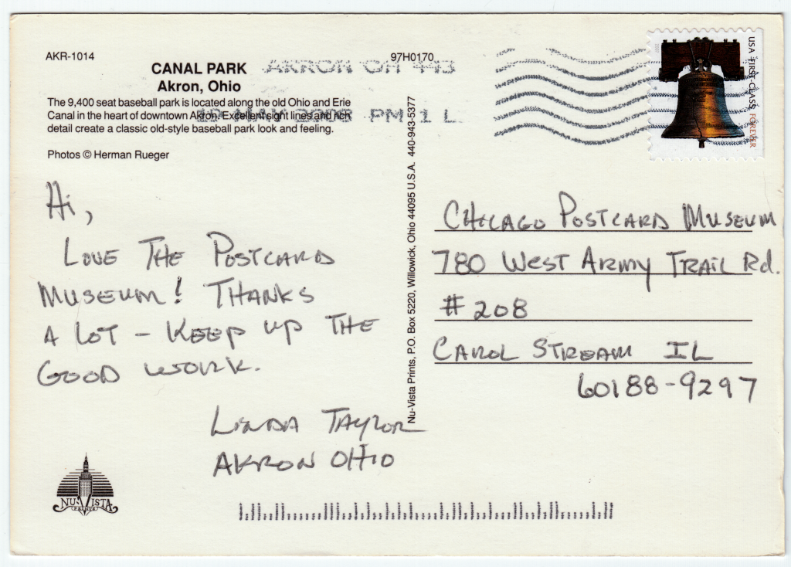
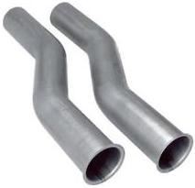
The Internet is a packet switched network (sending "postcards" of data).
TCP creates the illusion of a bidirectional, reliable "pipe" for data.
→

Slide 28
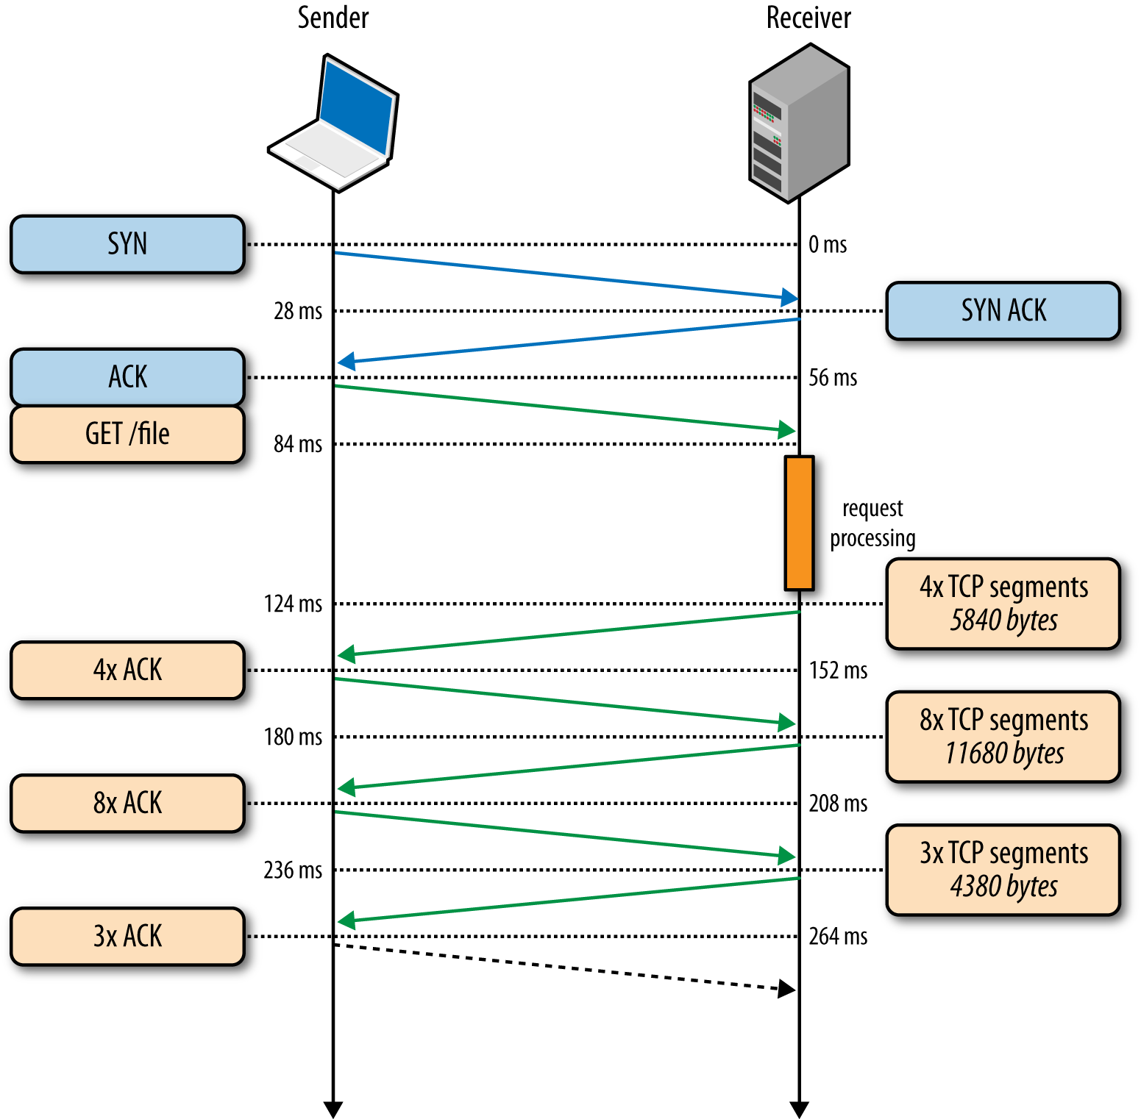
TCP streams
TCP provides applications with a file-like abstraction for a network connection.
  Just read and write to the connection. It’s like a pipe.
Packets are reassembled and ordered automatically by the OS/library.
Must establish a connection first, using a 3-way handshake.
We’ll talk about TCP details later in the class

Slide 29
TCP overview
Reliable transport between sending and receiving processes
Provides:
Port numbers so a computer can have multiple network connections
Message fragmentation & reassembly
Delivery confirmation & retransmission
Flow control: sender won’t overwhelm receiver
Congestion control: throttle sender when network is overloaded
Disadvantages:
Must first setup a connection between client and server processes
No timing or minimum throughput guarantees
Lacks encryption
Illusion of a reliable queue/“pipe”

Slide 30
UDP is a simpler alternative to TCP
For applications that don’t need a reliable connection.
Avoids the setup delays associated with TCP handshake
Protocols built on UDP must deal with more error conditions.
Like plain IP packets, but adds port numbers
Examples:
  Session Initiation Protocol (SIP) for setting up VoIP calls.
  Realtime Transport Protocol (RTP) for sending audio in VoIP call
We’ll talk more about UDP and TCP in detail in Chapter 3.

Slide 31
Layering review
Ethernet Packet
MAC addresses, CRC, etc.
Ethernet payload
Ethernet Packet
MAC addresses, CRC, etc.
IP Packet
IP addresses, TTL, etc.
IP payload
IP Packet
IP addresses, TTL, etc.
TCP Packet
Port #, sequence #, ack #, etc.
TCP payload
TCP Packet
Port #, sequence #, ack #, etc.
TCP payload continued
HTTP Response
url, content-type, date, etc.
<html><body><h1>My great page</h1><p>…
HTTP Response Continued
…and that is all</p> </body></html>

Slide 32
Recap – Introduction to the Internet
Packets travel along many hops to reach the intended destination
  Each router has a fixed-size queue; packets are dropped if full
  Packet is also dropped if a bit-flip error is detected
Showed four different sources of packet delay at each hop:
  Nodal processing, queueing (associated with the router)
  Transmission, propagation (associated with the link)
Internet is a “network of networks”
  Tier 1 ISPs and big content providers build high-speed backbone links.
  Peering is when networks connect to each other without any payment.
Networks use layered protocols, eg.: Ethernet, IP, TCP, TLS, HTTP
Socket is a software abstraction of a network connection (TCP or UDP)
  It’s one end of a pipe: you can send data in or get data out
  Each socket is bound to a particular port number. Port number determines which process on a host is responsible for handling a given packet.

