Slide 1
CS-340 Introduction to Computer Networking
Lecture 6: TCP
Steve Tarzia
Many diagrams & slides are adapted from those by J.F Kurose and K.W. Ross
Many TCP flow diagrams from Stevens’ “TCP/IP Illustrated Vol. 1” 1st ed.

Slide 2
Last Lecture
Apps can send individual packets w/UDP; delivery is not guaranteed.
  Adds a port number and checksum to packets.
But most apps want reliable, stream-oriented transport (eg., TCP):
Delivery confirmation & ordering is possible by sending ACKs
  After a timeout, resend packet that was not ACK’ed.
Pipelining packets allow much better use of link capacity.
  Parallelizes ACK’ed communication
  Window size determines the number of allowed in-flight packets
Go Back N is a simple pipelining protocol that uses cumulative ACKs.
Selective Repeat adds buffering to the receiver to avoid unnecessary repetition.

Slide 3
TCP is practical reliable transport
Has evolved from 1970s through today.
Uses positive ACKS. Combines ideas from go-back-N and selective repeat.
Also manages connection pacing (flow & congestion control)
Unlike UDP, TCP requires that two hosts setup a connection before exchanging data. Why?
  Exchange initial sequence numbers for both directions of the connection.
Choose a random initial sequence number for two reasons:
  So new packets are not confused with retransmission from prior connection.
  So an attacker cannot easily inject fake packets in the data stream.

Slide 4
TCP packet structure
32 bits
URG: urgent data
(generally not used)
counting by bytes
of data
(not segments!)
source port #
dest port #
sequence number
ACK: ACK # is valid
acknowledgement number
head
len
not
used
U
A
receive window
PSH: push data now
(generally not used)
P
R
S
F
checksum
urgent data ptr
# bytes receiver is
willing to accept
RST, SYN, FIN:
connection establishment
(setup, teardown commands)
options (variable length)
application data
(variable length,
as indicated in
IP header)
Any TCP packet can carry an ACK number, so ACKs can be “piggy backed” on data flowing in the opposite direction.
checksum
(as in UDP)

Slide 5
TCP seq #s and ACKs
outgoing segment from sender
source port #
dest port #
sequence number
Sequence Numbers:
  Indicate the offset in the byte stream of the segment’s first byte
Cumulative ACKs:
  Send next expected sequence number (like Go Back N)
Receiver may drop out-of-order segments (like GBN), or buffer them for later reassembly (like Selective Repeat).
acknowledgement number
rwnd
checksum
urg pointer
app data …
window size
N
  sender sequence number space
sent,
ACKed
sent, not-yet ACKed
(“in-flight”)
usable,
but not
yet sent
not
usable
incoming segment to sender
source port #
dest port #
sequence number
acknowledgement number
A
rwnd
checksum
urg pointer

Slide 6

Simple TCP example (after the handshake)
Seq = index of data being sent.
ACK = index of data it expects to receive next
Web Browser
Seq_{init}=42
Web Server
Seq_{init}=79
Visits page, sending 100-byte long HTTP request
Seq=42, ACK=79, data = ‘GET /index.htm HTTP/1.1\r\nHost:…’
Server ACKs request, and sends back 1200 bytes of HTML
Seq=79, ACK=142, data = ‘HTTP/1.1 200 OK…’
Client ACKs HTML body. Does not have any other data to send.
Seq=142, ACK=1279, data = ‘’
Server has already ACK’ed 142+0, so don’t send an ACK.

Slide 7
Timeouts are an important parameter
TCP keeps one timer, for oldest un-ACK’ed segment
  Retransmit that one segment when timer expires. Why just one?
  ACK received → start timer for next-lowest un-ACK’ed segment, if any.
Timer must be set carefully:
  Too long → waste time waiting before a necessary retransmit.
  Too short → send duplicate packets unnecessarily.
What is the ideal value of the timer?
  In other words, how much time do we expect to elapse before getting ACK?
  Answer: just slightly longer than expected round-trip time (RTT).
Thus, TCP keeps track of recent RTTs by constantly measuring
delay between every transmission and its ACK.
STOP
and
THINK
STOP
and
THINK

Slide 8
Exponentially-weighted moving average RTT
EstimatedRTT = (1-α)*EstimatedRTT + α*SampleRTT
Every time a new SampleRTT is observed, update the EWMA RTT.
Typically, α = 0.125
Gives us a “smoothed”
average of recent RTT.
Then set
timeout > EstimatedRTT
But how much greater?
RTT: gaia.cs.umass.edu to fantasia.eurecom.fr
RTT (milliseconds)
STOP
and
THINK
sampleRTT
EstimatedRTT
time (seconds)

Slide 9
RTT variance (jitter) also affects timeout choice
Square points show traffic with high variance in RTT (high jitter)
  Should choose
  timer significantly > EstimatedRTT
Circle points show traffic with low variance in RTT (low jitter)
  Can choose timer just slightly > EstimatedRTT

Slide 10

Final RTT estimation
Also track an exponentially-weighted moving average of RTT deviation (jitter):
DevRTT = (1-β)*DevRTT + β*|SampleRTT-EstimatedRTT|
Typically β=0.25
Add a multiple of DevRTT as a “safety margin” above EstimatedRTT:
TimeoutInterval = EstimatedRTT + 4*DevRTT
Initially set Timeout to one second, until we have some measurements.

Slide 11
Timeout initially set to one second
High RTT, high jitter
Moving average makes the TimeoutInterval adaptive to changing network conditions
High RTT,
low jitter
Low RTT period

Slide 12
Intermission

Slide 13
TCP retransmission scenarios
STOP
and
THINK
What if the second ACK is dropped instead of the first?
SendBase=92
Seq=92, 8 bytes of data
Seq=92, 8 bytes of data
Seq=92, 8 bytes of data
timeout
timeout
Seq=100, 20 bytes of data
Seq=100, 20 bytes of data
ACK=100
X
timeout
ACK=100
ACK=100
X
ACK=120
ACK=120
Seq=92, 8 bytes of data
Seq=92, 8
bytes of data
SendBase=100
Seq=120, 15 bytes of data
SendBase=120
ACK=100
ACK=120
SendBase=120
Lost ACK
Premature timeout
Lost ACK, but cumulative ACK
prevents retransmission

Slide 14
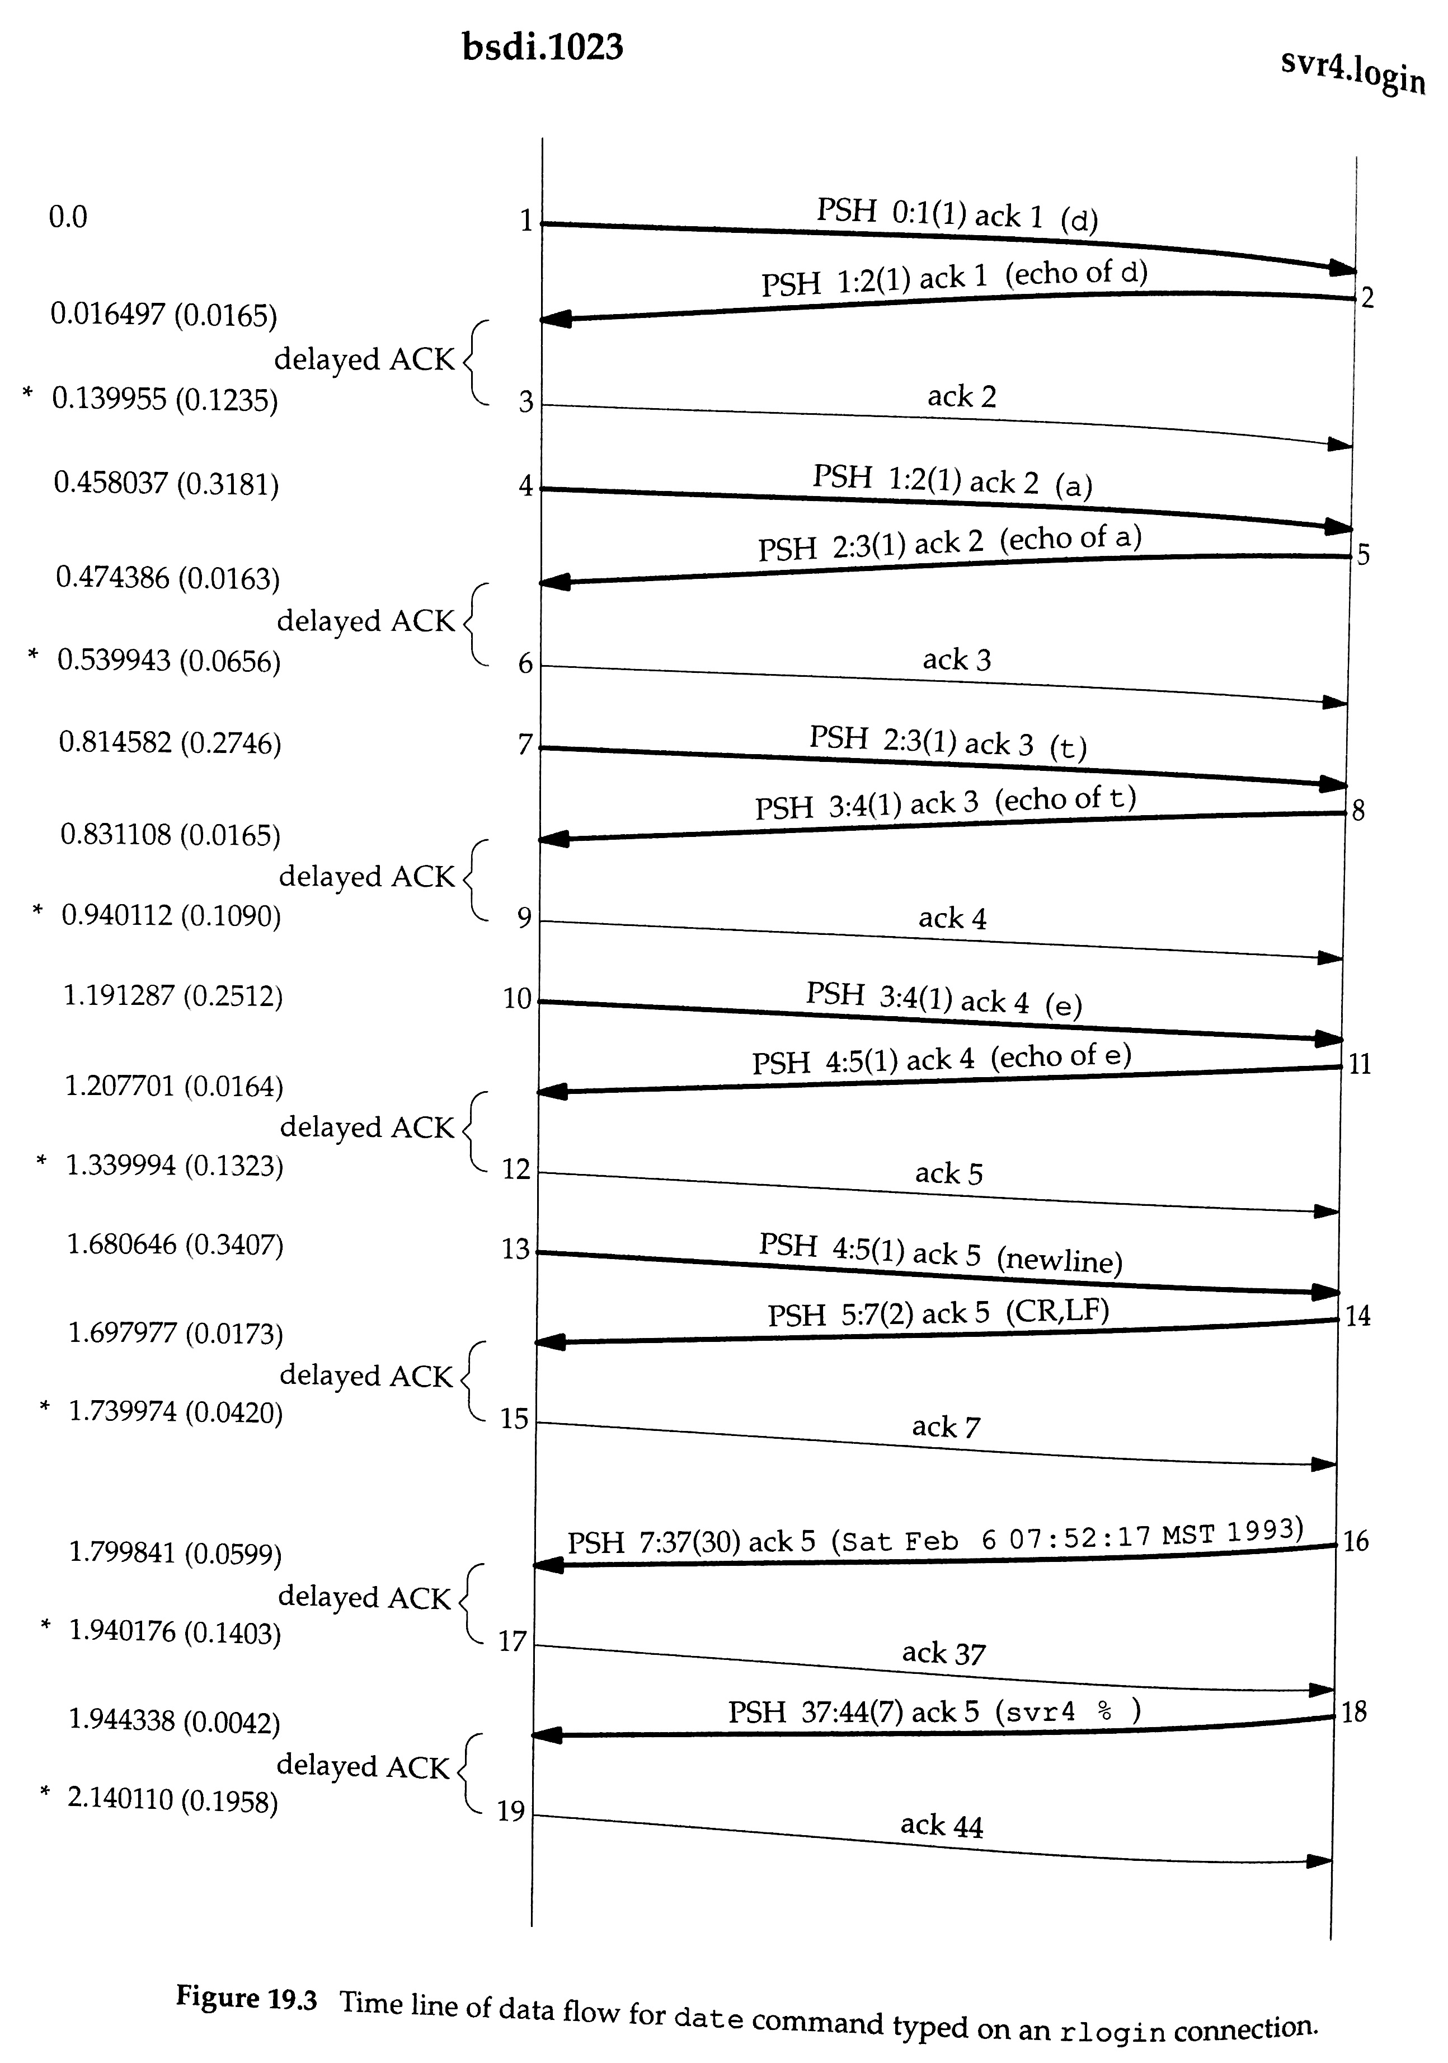
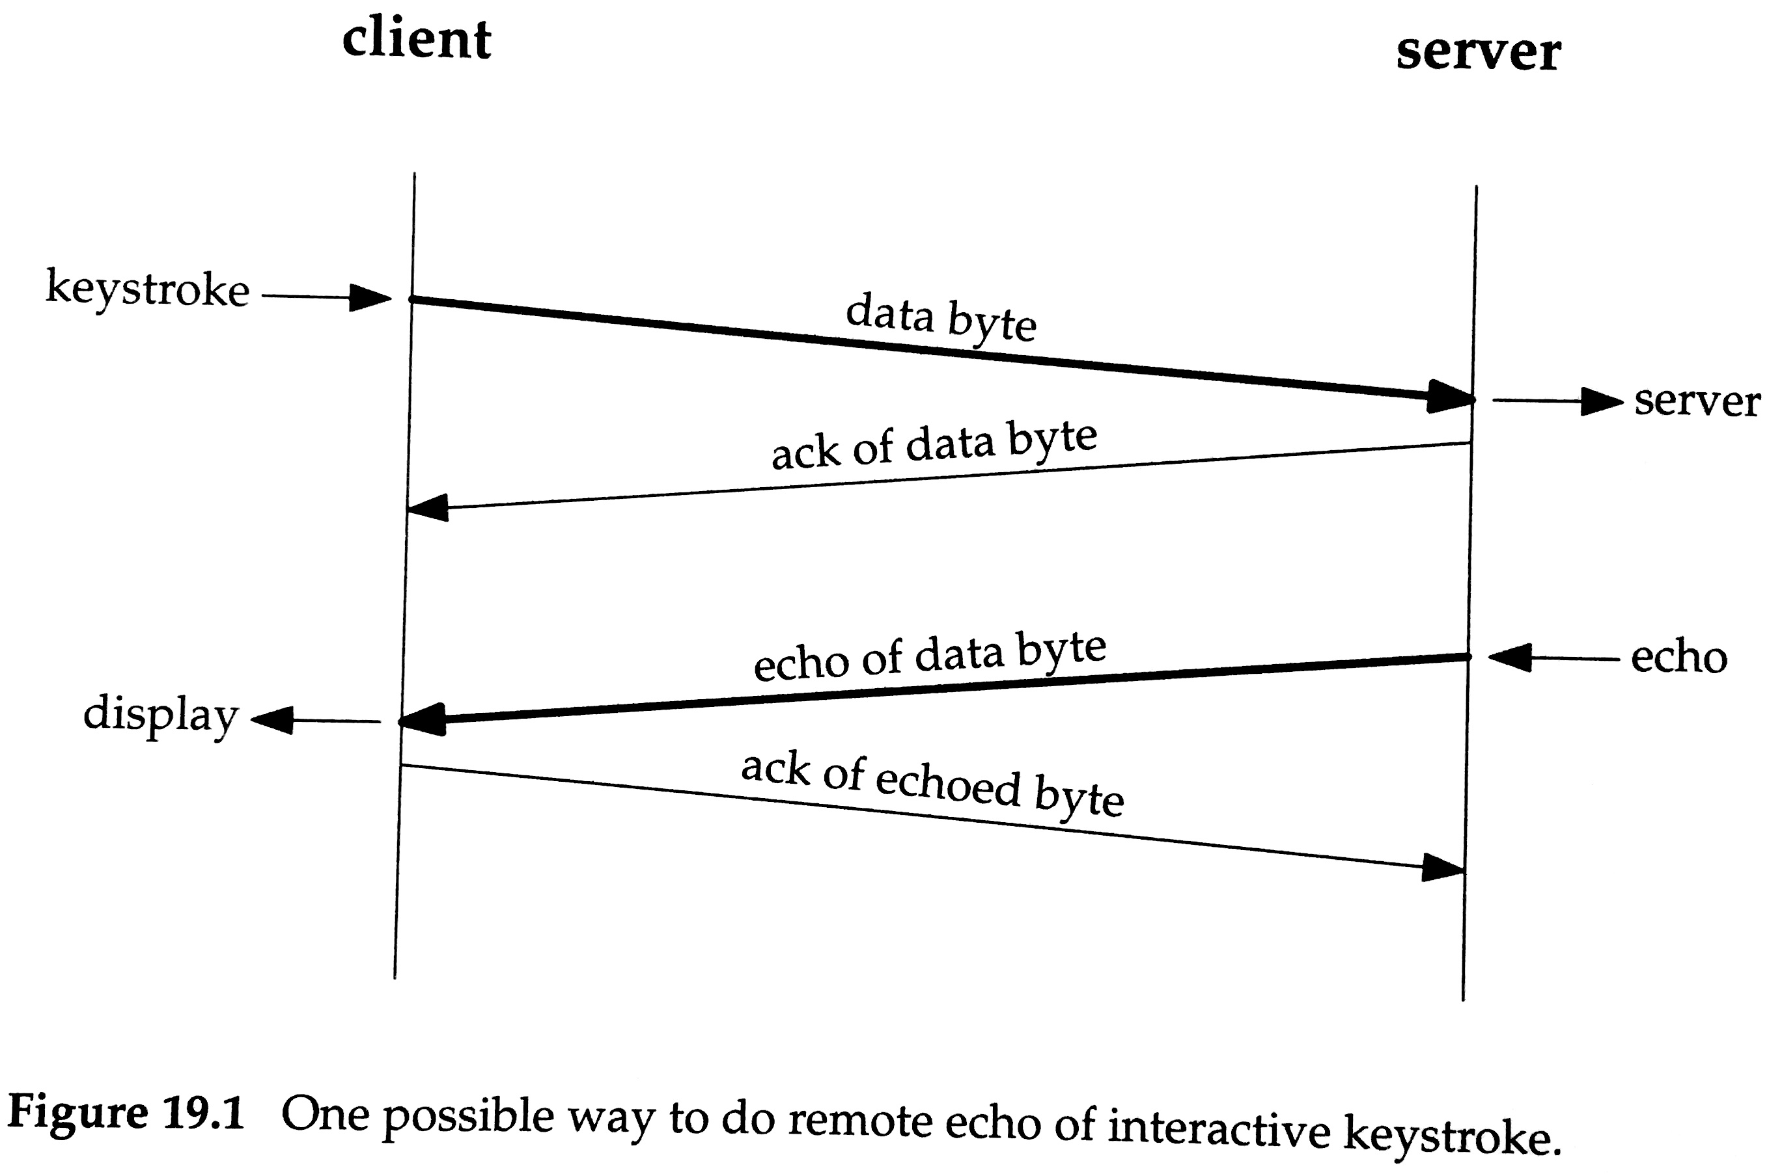
Delayed ACKs
TCP recommends that receiver wait before sending an ACK (RFC 1122).
This allows the TCP’s ACK response (and receive window update) to be piggy-backed on an application-layer response.
Send ACK only after 500ms or with next data in other direction.
Eg., an “echo” app that repeats back the data received:
Eager ACKs
With delayed ACKs
processing
time
delayed
ACK
delayed
ACK

Slide 15
TCP ACK generation (RFC 1122, 2581)
Event at Receiver
TCP action taken
Arrival of in-order segment with expected seq #. All data up to expected seq # already ACK’ed.
Arrival of in-order segment with expected seq #. One other segment has ACK pending.
Arrival of out-of-order segment
(with higher-than-expect seq #).
In other words, a gap was detected.
Arrival of segment that partially or completely fills gap.
Delayed ACK. Wait up to 500ms for next segment. If no next segment, send ACK.
Immediately send a single
cumulative ACK, ACK’ing both in-order segments.
Immediately send duplicate ACK, indicating seq. # of next expected byte.
Immediately send ACK if segment starts at beginning of gap.

Slide 16
TCP fast retransmit
With using cumulative ACKs,
duplicate ACKs suggest packet loss.
  Receiver will always set ACK # to the index of the next byte expected (the gap).
On triple duplicate ACK, instead of the sender waiting for timer to expire, TCP fast retransmit immediately re-sends lowest un-ACK’ed segment.
Seq=92, 8 bytes of data
Seq=100, 20 bytes of data
X
ACK=100
timeout
ACK=100
ACK=100
ACK=100
Seq=100, 20 bytes of data
fast retransmit after sender
receipt of triple duplicate ACK

Slide 17
Triple DUP ACK
Why does TCP wait for three duplicate ACKS before performing a fast retransmit? Why not after one?
RFC 2001:
  “Since TCP does not know whether a duplicate ACK is caused by a lost segment or just a reordering of segments, it waits for a small number of duplicate ACKs to be received. It is assumed that if there is just a reordering of the segments, there will be only one or two duplicate ACKs before the reordered segment is processed, which will then generate a new ACK. If three or more duplicate ACKs are received in a row, it is a strong indication that a segment has been lost.”
STOP
and
THINK

Slide 18
TCP has characteristics of both GBN and SR:
Go Back N
Selective Repeat
Only one timer is kept, but →
Send cumulative ACKs, but →
Duplicate ACK for early segment.
Re-send just one segment on timeout.
Receiver may save out-of-order segments for later reassembly.
Plus some new features:
Guidelines for setting timeout interval, based on observations
Delayed ACKs. • Triple duplicate ACK triggers a retransmit.
Connection setup with 3-way handshake, and teardown.
Window size changes to implement flow & congestion control

Slide 19
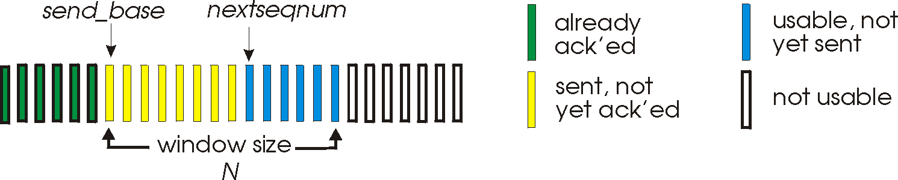
TCP window → flow and congestion control
Recall that window size limits the maximum # of in-flight segments.
Peak throughput is proportional to window size (divided by RTT).
  Hosts control windows, not RTT.
Control sender’s window size to prevent packet loss, by preventing:
  Overflow of receiver’s receive buffer (flow control).
  Overflow of routers’ packet queues (congestion control).
Sender
Receiver
# segments ≤ N

Slide 20
TCP flow control – to avoid overwhelming the receiver
In receive window, host tells how many bytes of new data it can receive.
Sender simply tracks # un-ACK’ed bytes and keeps this ≤ receive window.
  A simple and effective solution is possible because we can directly observe the receive buffer and report its status.
Congestion control requires a more complex solution because it involves many routers along the path, and many flows (connections) across each router.
  We must infer network congestion.
32 bits
source port #
dest port #
sequence number
acknowledgement number
head
len
not
used
U
A
receive window
P
R
S
F
checksum
urgent data ptr
options (variable length)
application data

Slide 21
TCP connection setup
Before starting data exchange, hosts must agree on a few parameters:
  Initial sequence numbers (in both direction)
  Receive window size (for flow control)
Recall: choose a random initial sequence number for two reasons:
  So new packets are not confused with retransmission from prior connection.
  So an attacker cannot easily inject fake packets in the data stream.
Three-way handshake sets up the connection
  SYN: Initiator sends its parameters (init. seq #, window size, etc.).
  SYN-ACK: Listener sends ACK including its own parameters.
  ACK: Initiator ACKs (and may include first segment of data).
  Above ACKs use initial sequence number + 1

Slide 22
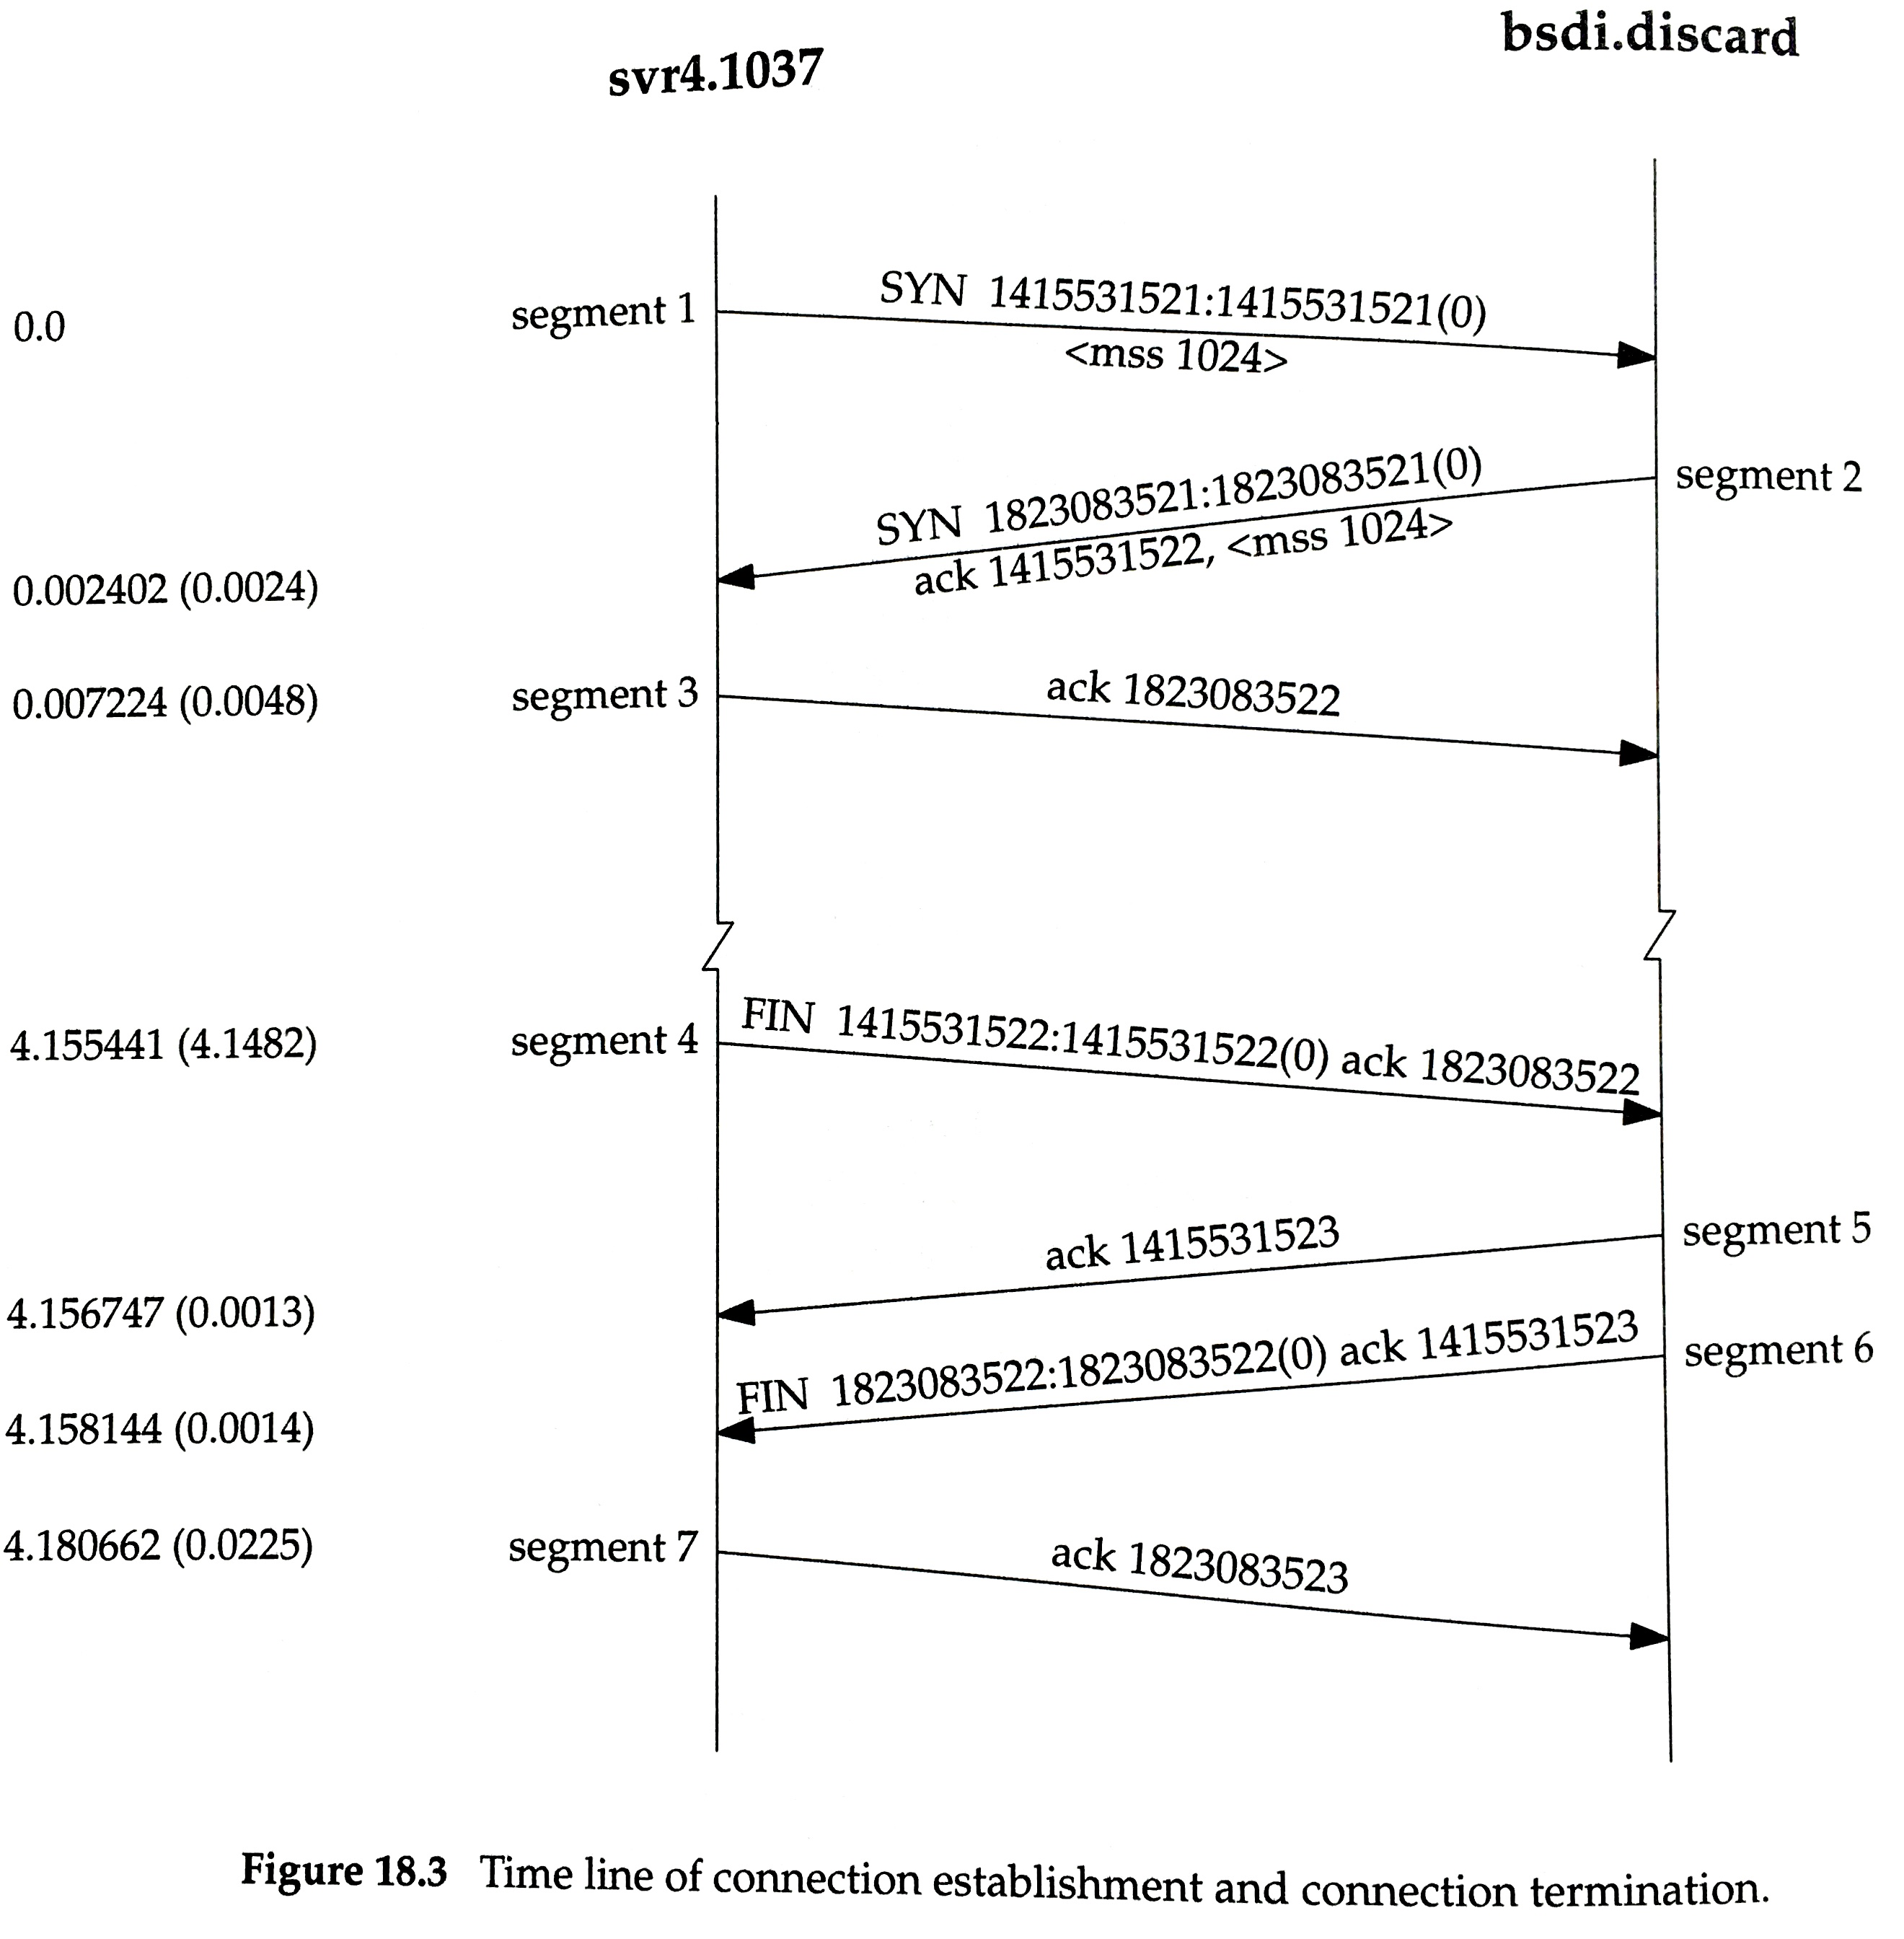
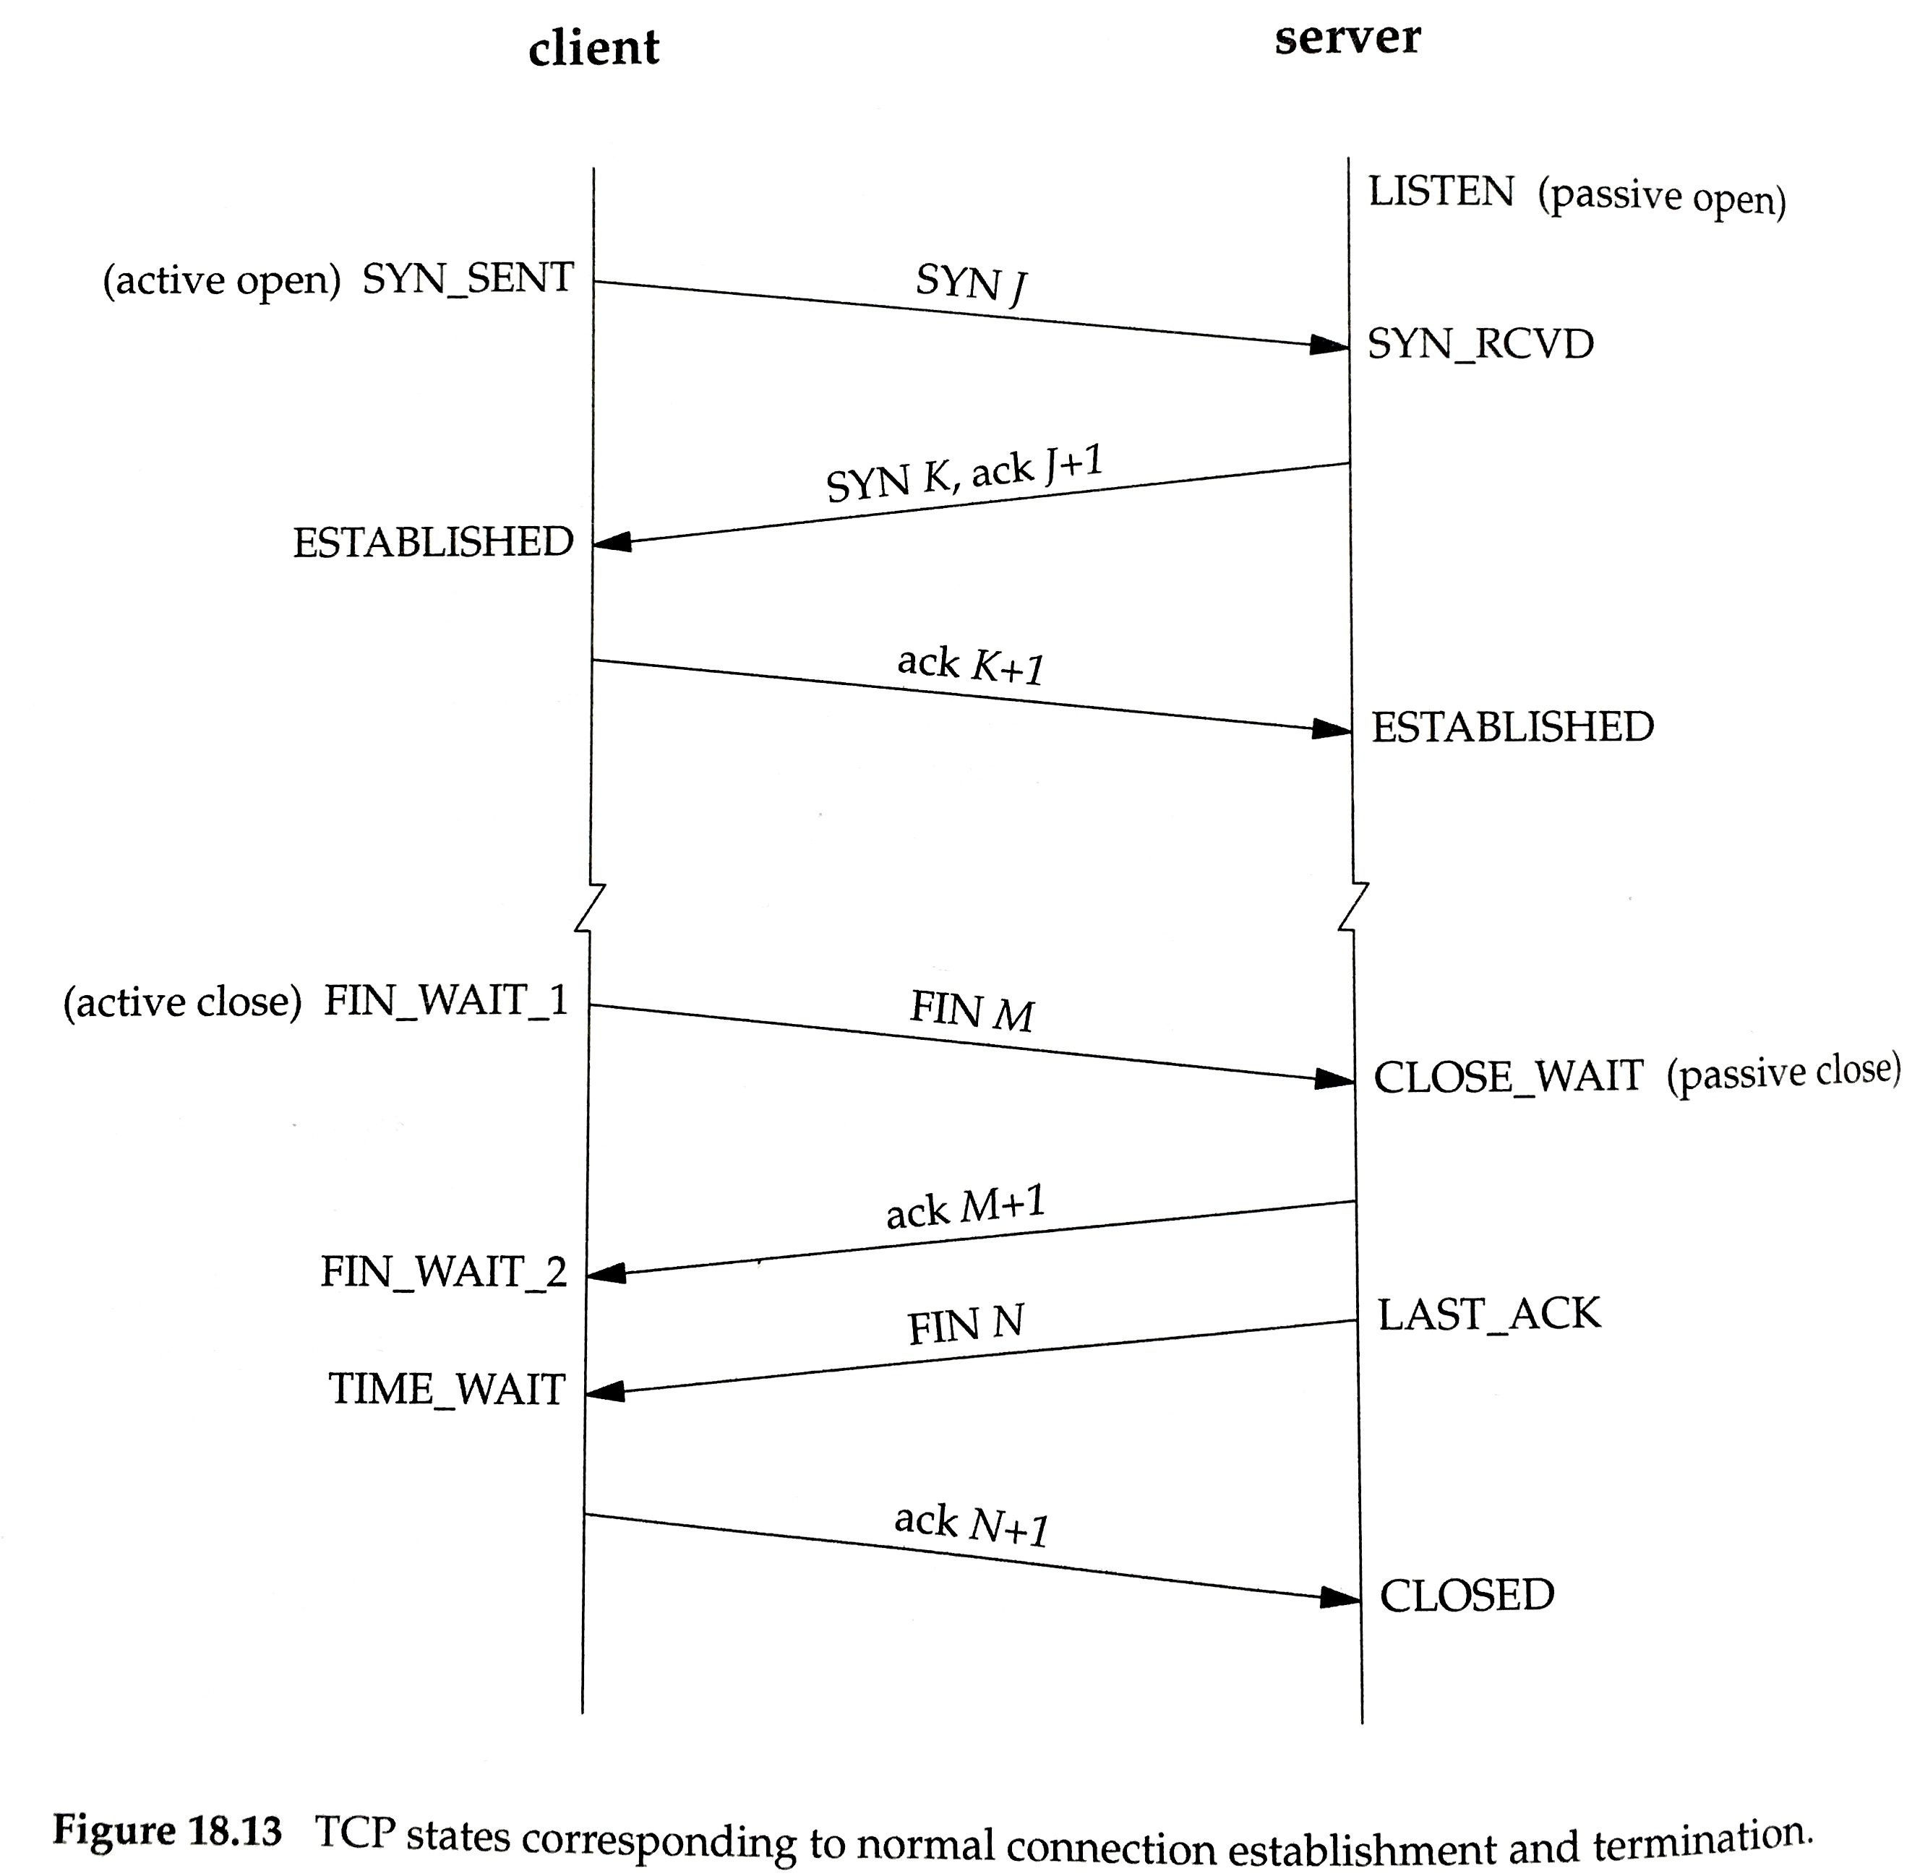
3-way handshake, from “TCP/IP Illustrated” reference book
An example:
In general:
seq # : end of data (data size)
May open a TCP socket:
Actively (we specify the connection partner, and a SYN is sent)
Passively (just listen for a SYN from unknown host)
Usually call the active initiator the client, and the passive listener the server.

Slide 23
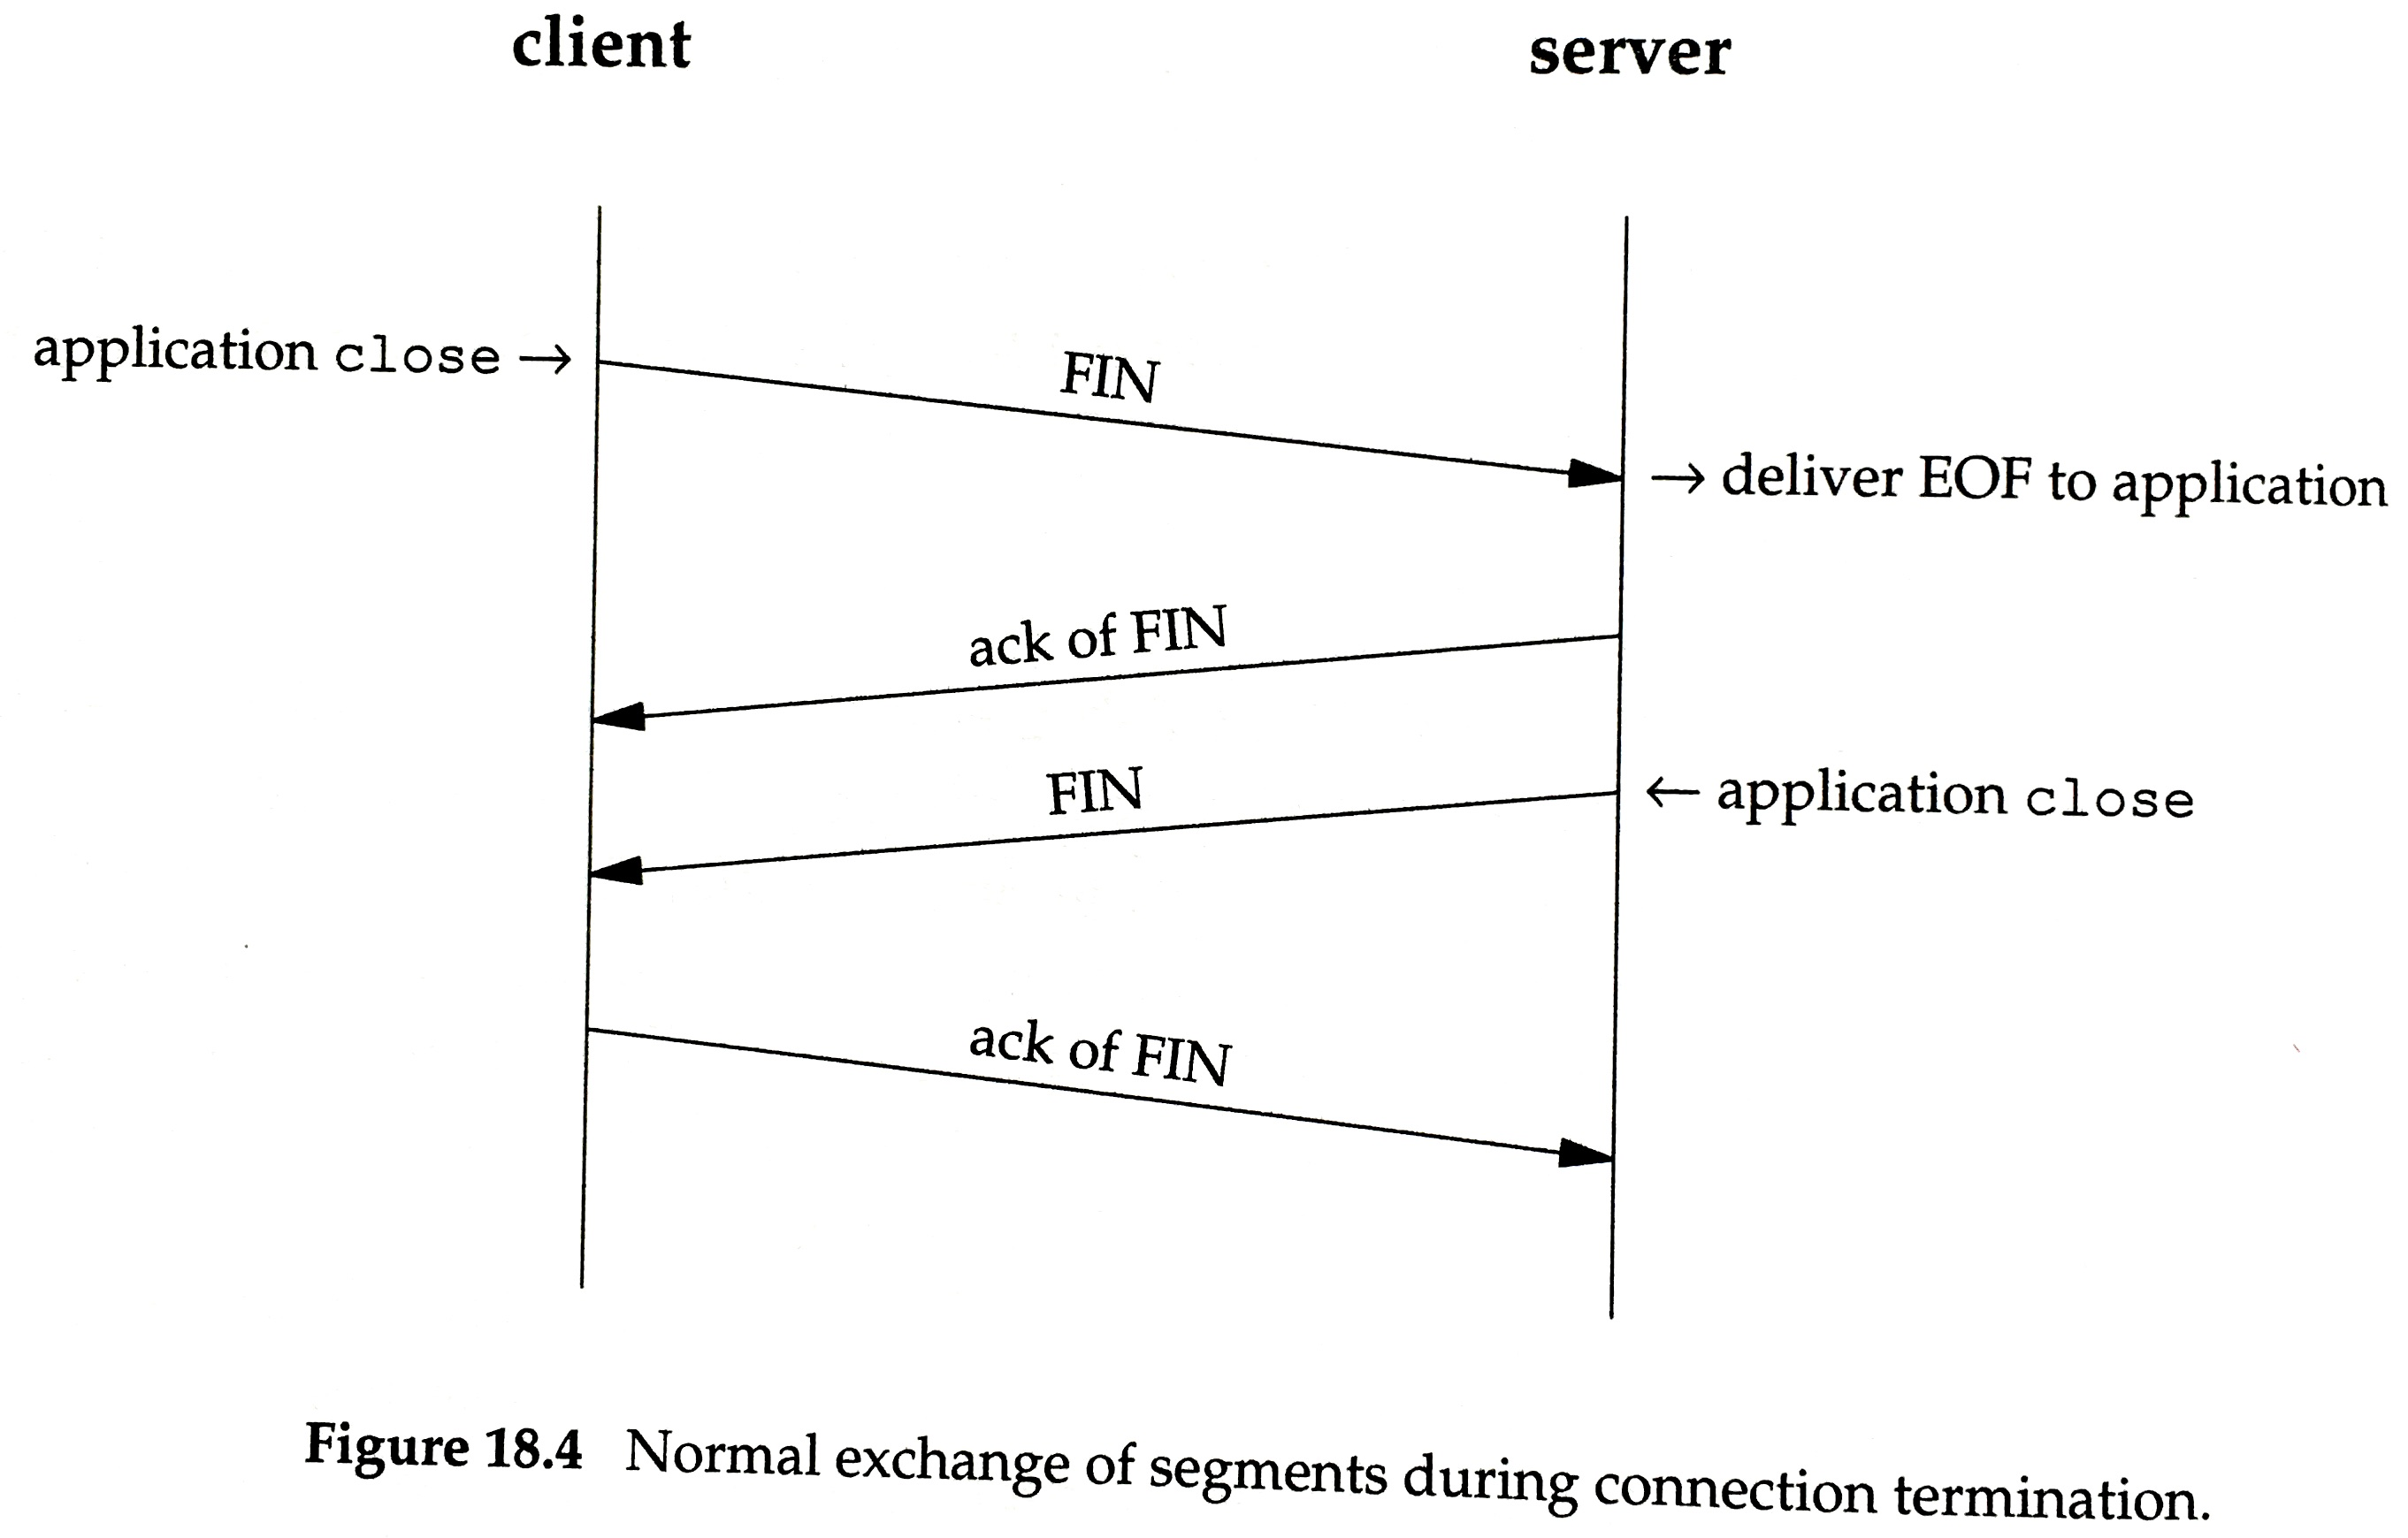
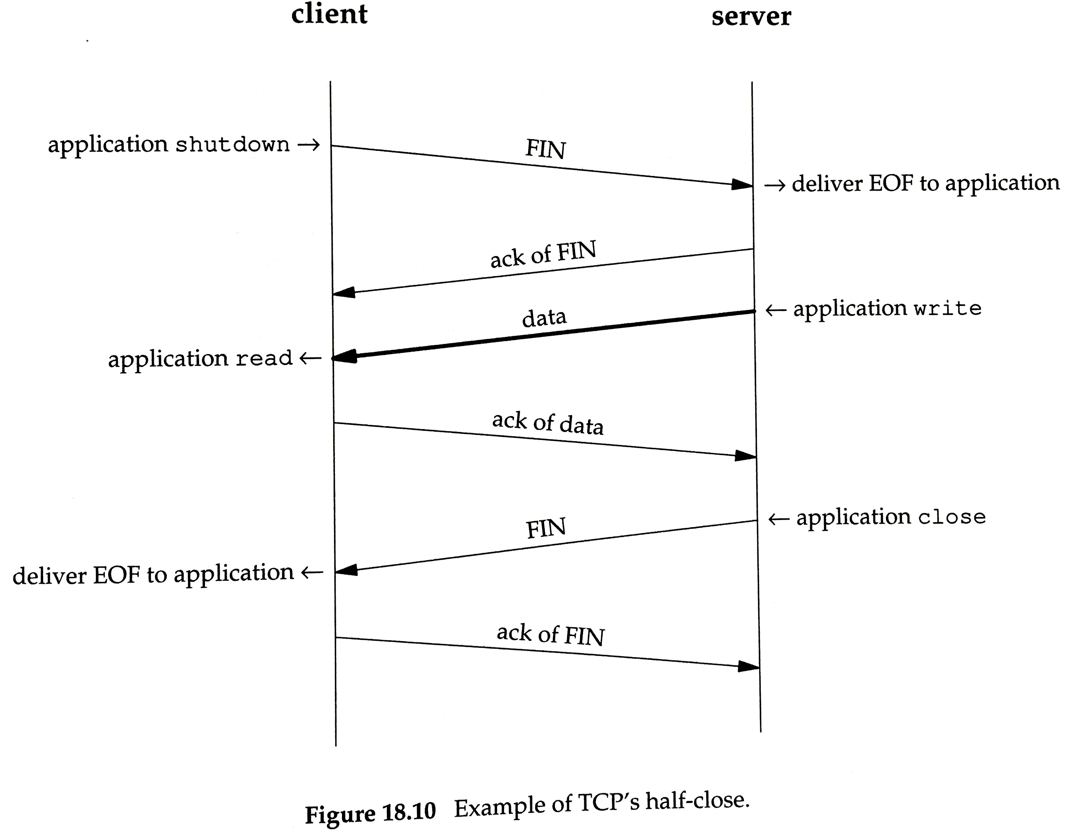
TCP connection close
Each side of the connection sends FIN to say it’s finished sending.
  Waits for an ACK.
  Connection may be half closed if only one side is done sending.

Slide 24
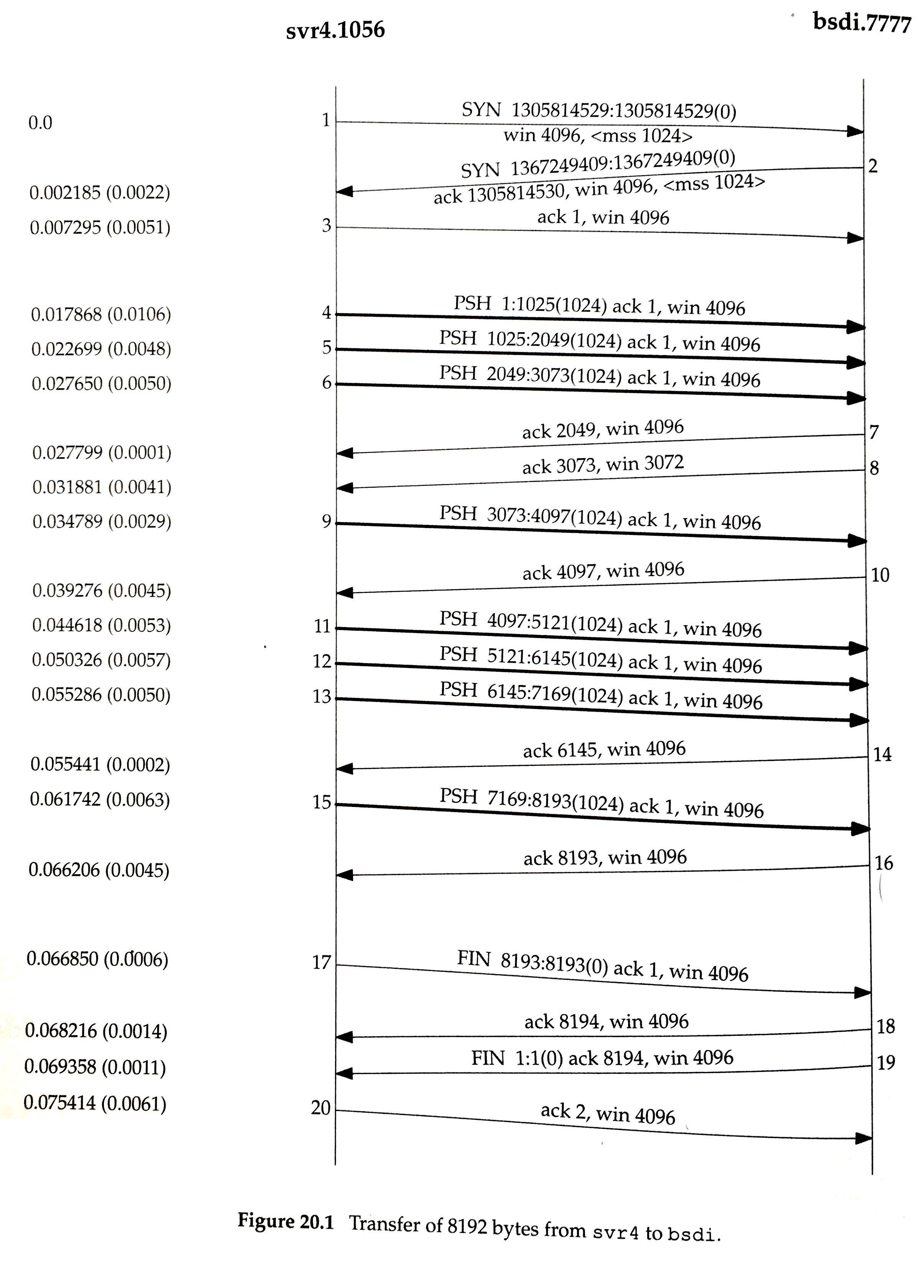
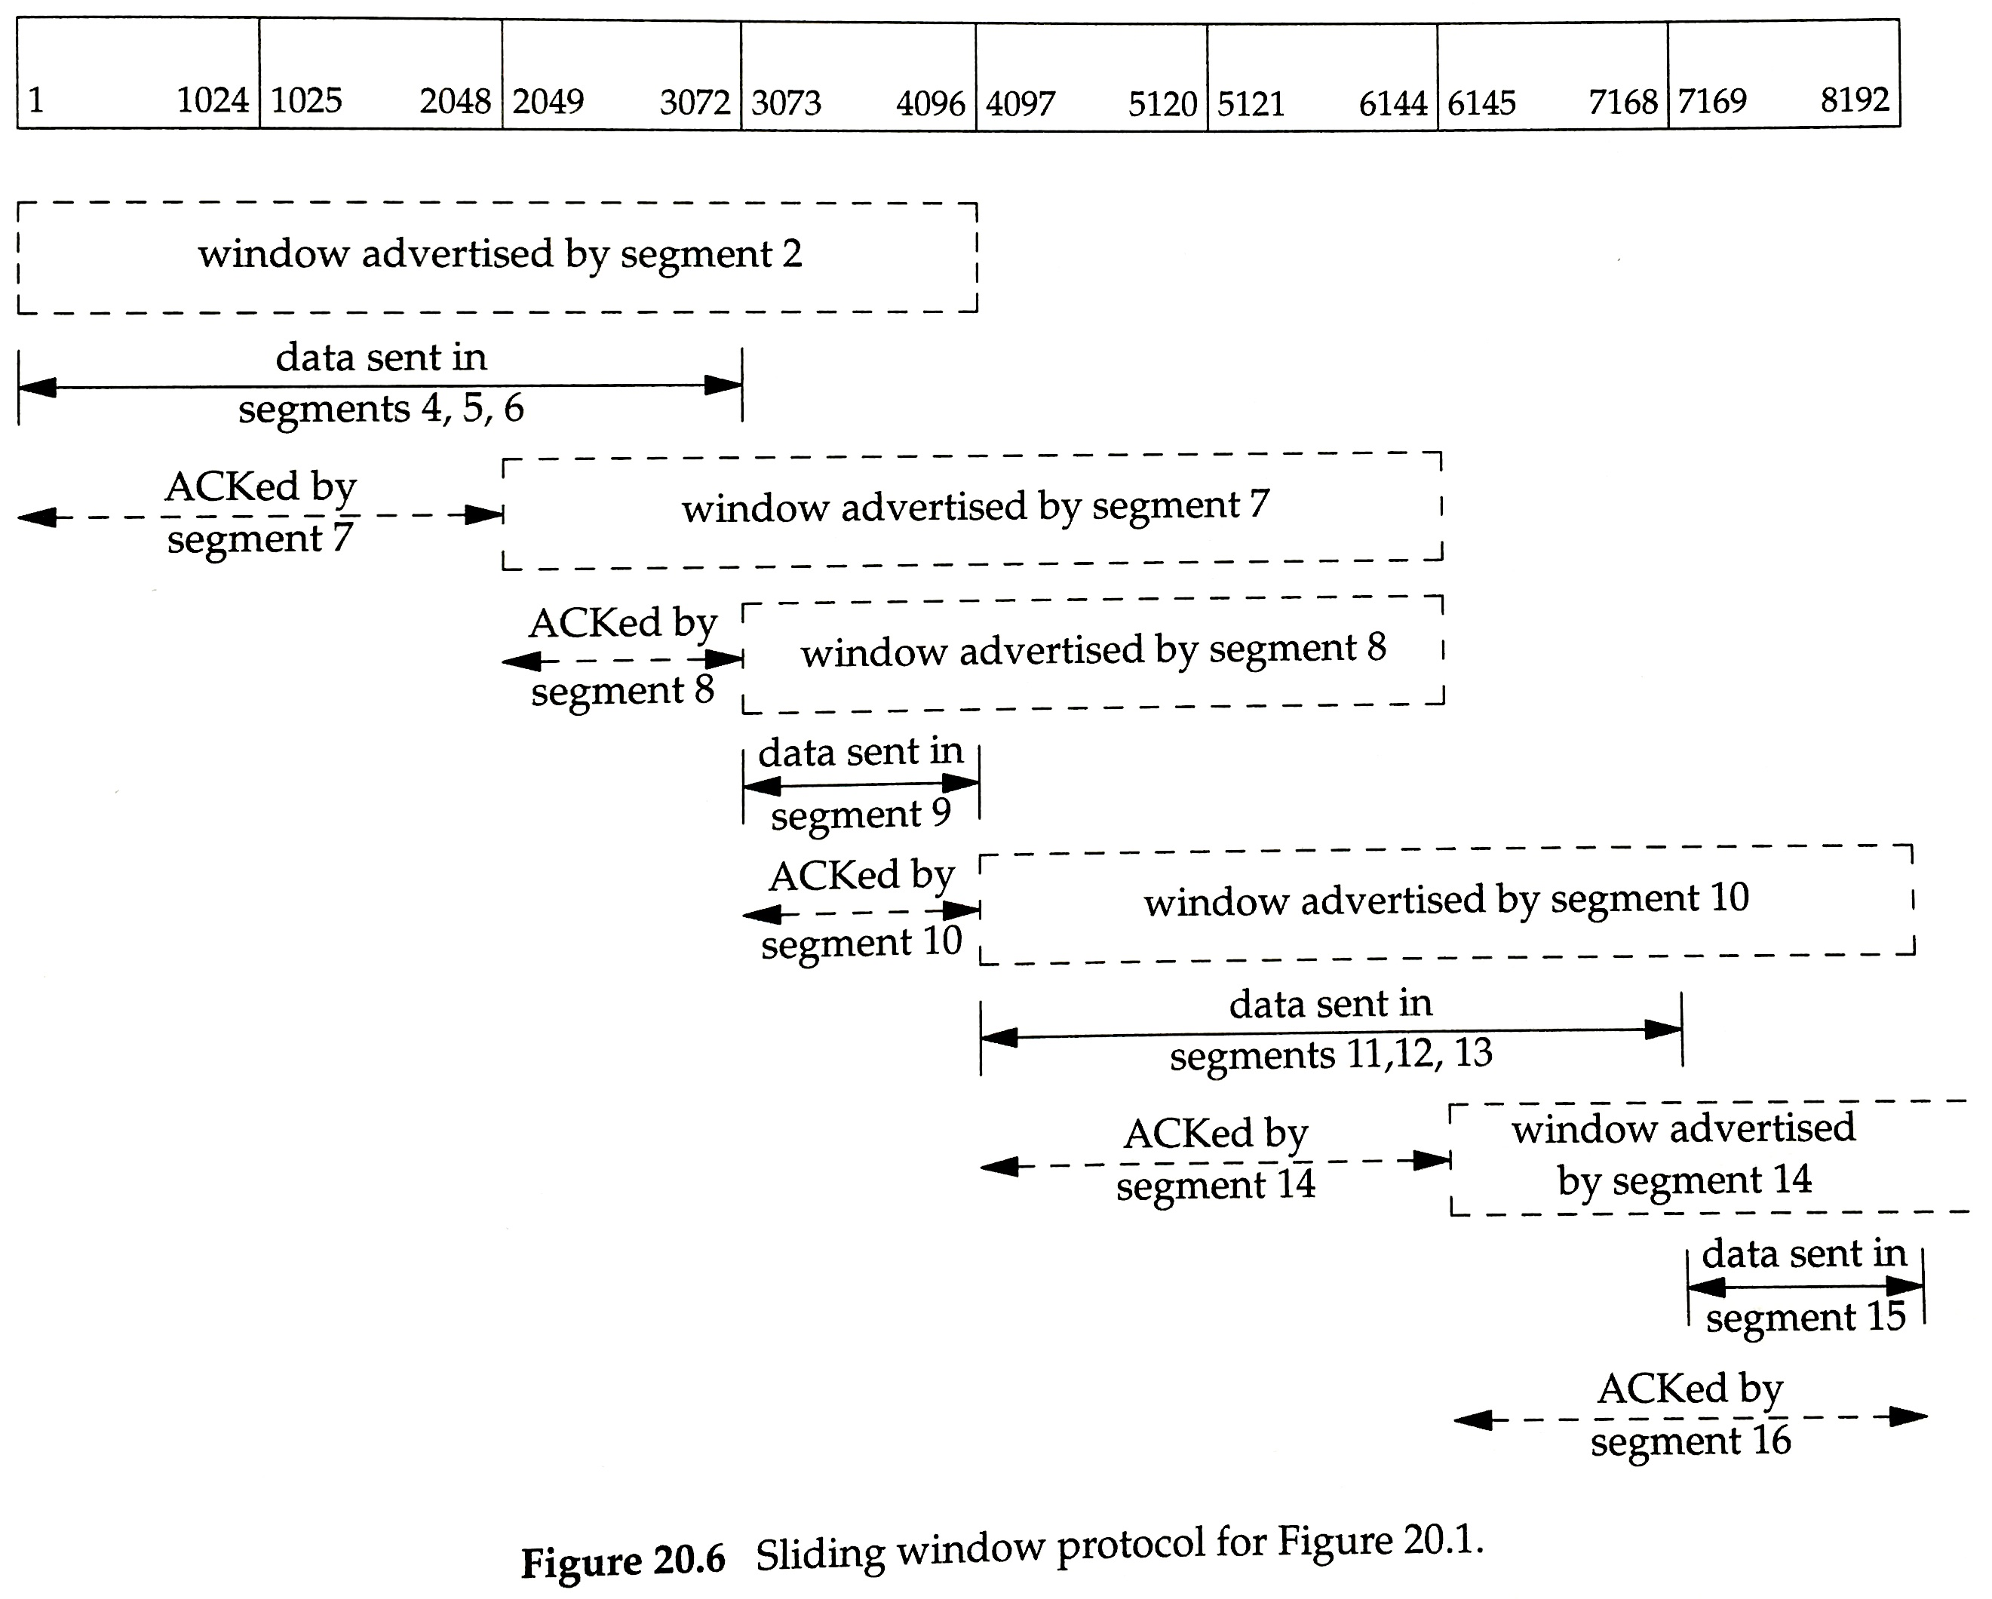

Slide 25
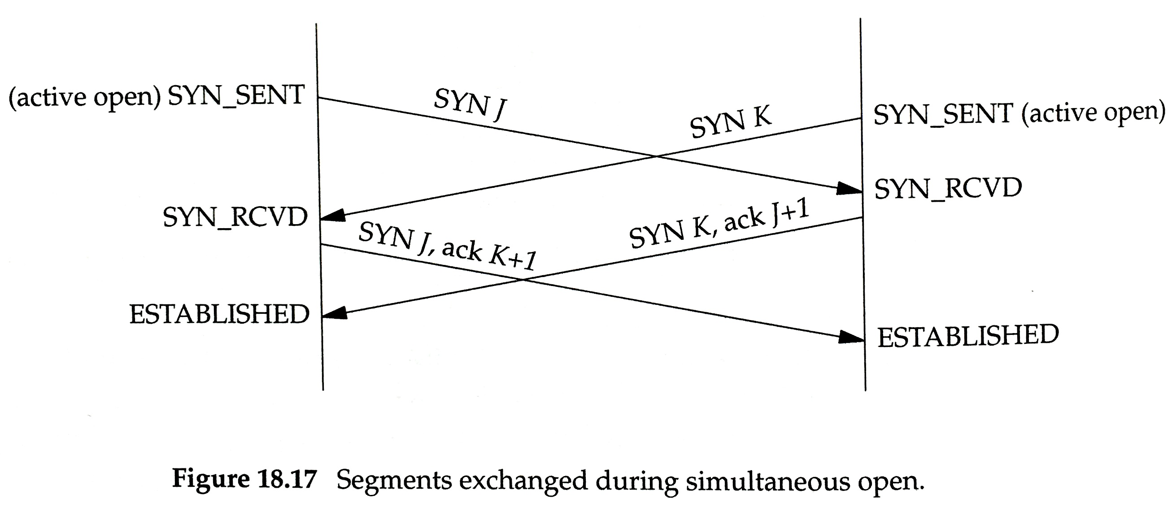
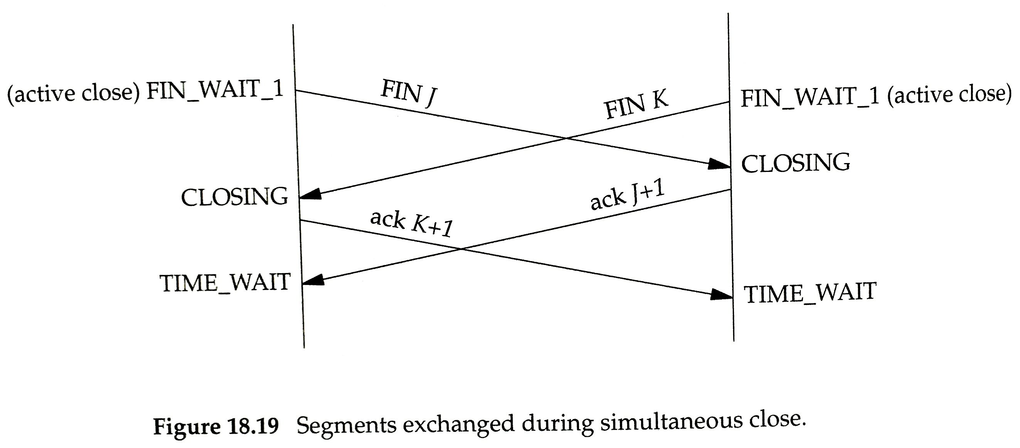
Protocol must also handle unusual timings

Slide 26
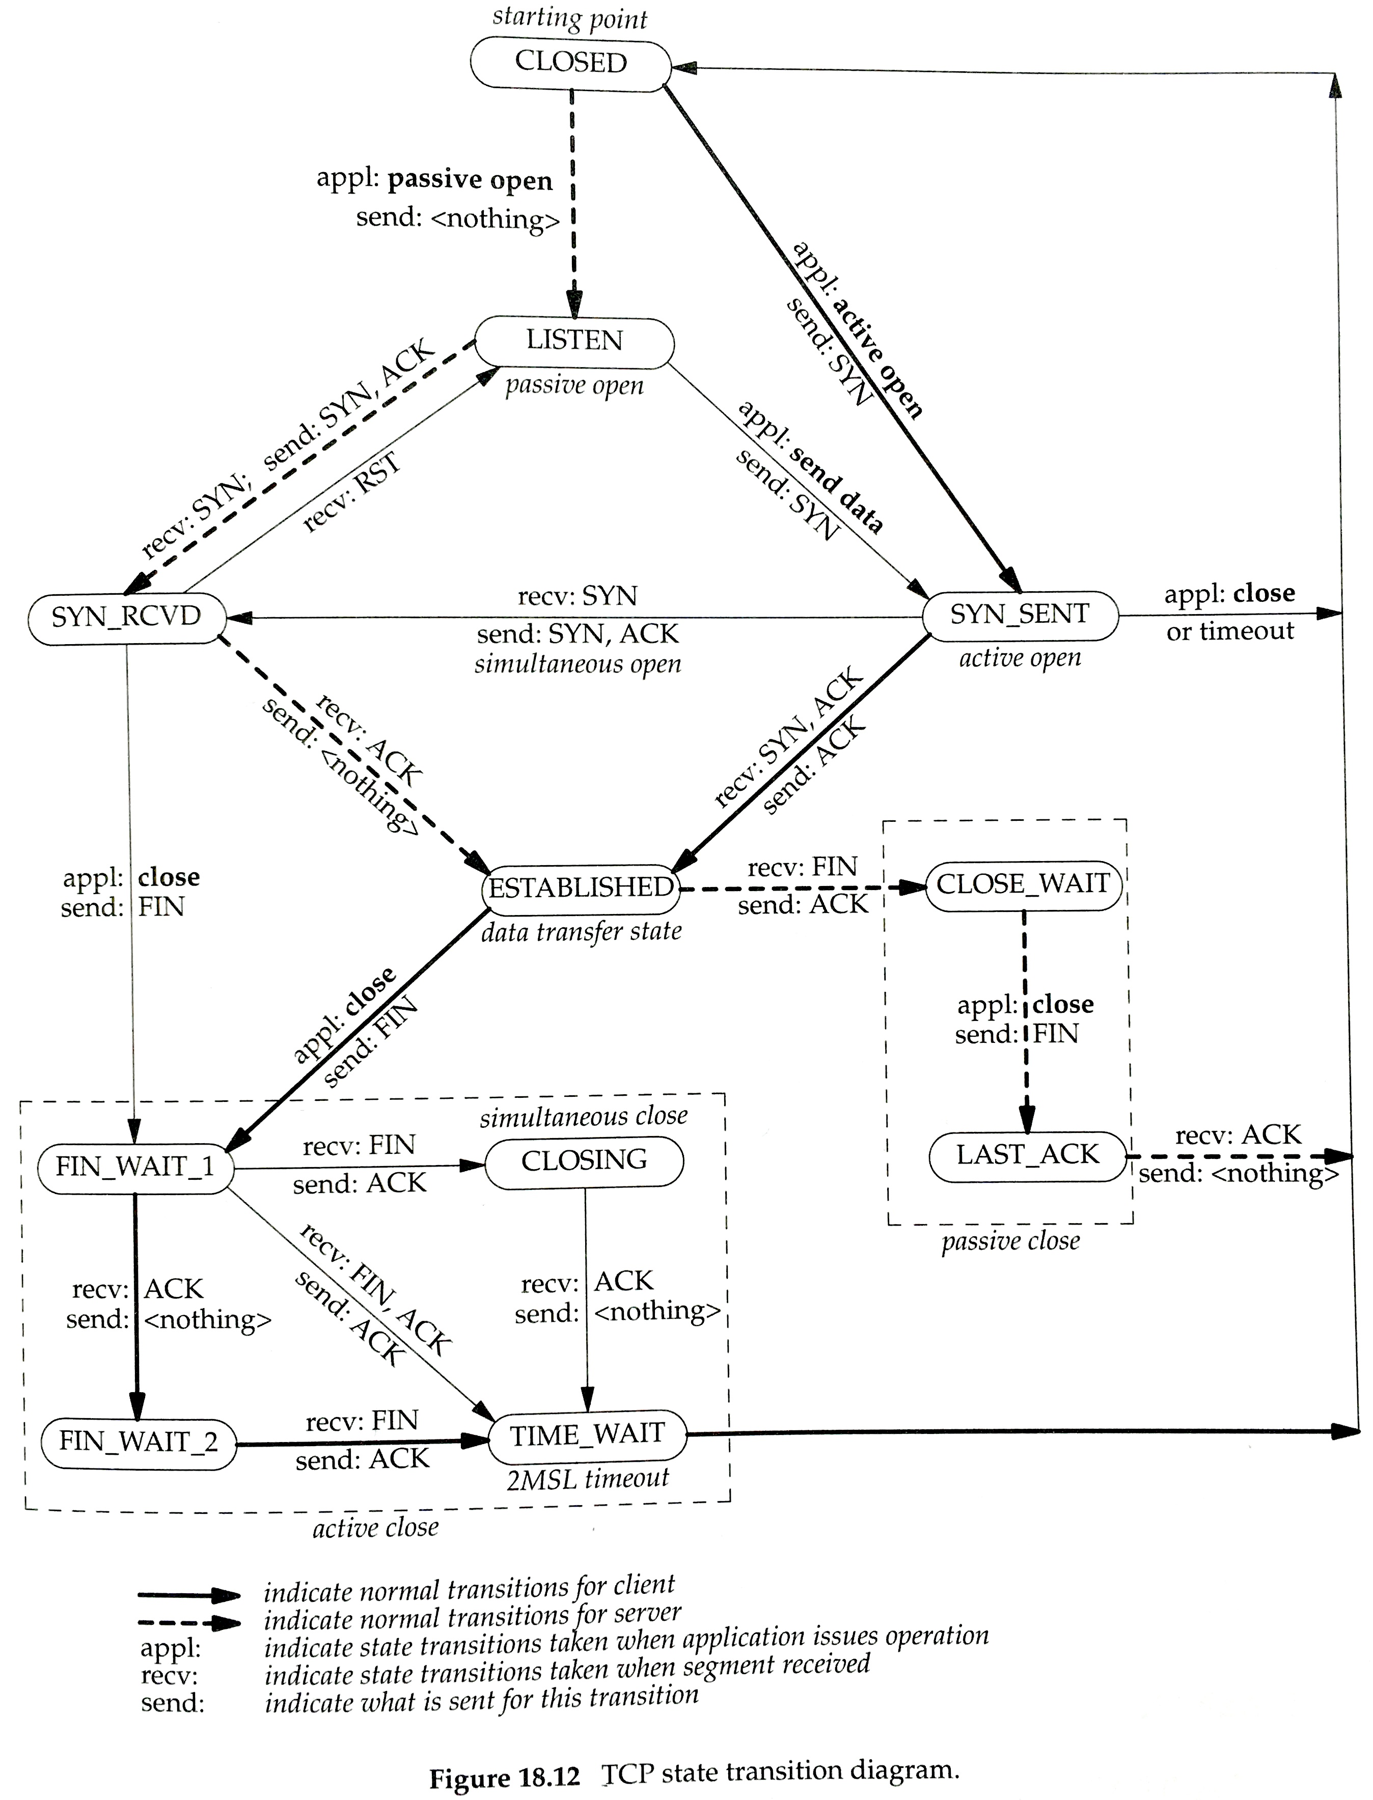
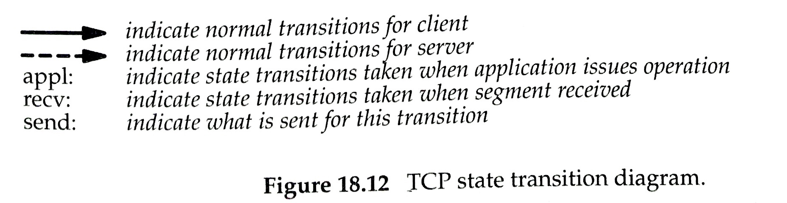
TCP state transition diagram

Slide 27
Recap
TCP implements a combination of Go Back N and Selective Repeat.
ACK timeout can be appropriately set with Exponentially-Weighted Moving Average (EWMA) of recent RTT and recent jitter.
ACKs count bytes, not packets, and can be piggybacked on data sent in the reverse direction. ACKs are sometimes delayed for efficiency.
Triple duplicate ACK suggests packet loss → retransmit.
Connection setup requires a 3-way handshake.
  Connection close also uses a handshake. Each direction is closed.
TCP throughput should be regulated so as not to overwhelm:
  the receiver -- Flow control is implemented with explicit Receive Window.
  the network – Congestion control will be discussed next lecture.

