Slide 1

EECS-343 Operating Systems
Lecture 10:
Threads
Steve Tarzia
Spring 2019

Slide 2
Announcements
Midterm exams are being graded as we speak.
Project 2 was due yesterday
Project 3 is due in two weeks from yesterday
  Must implement threads in xv6
  Should be easier than the last assignment
  There is an extra credit section
Homework 2 will be out soon.
Drop deadline is on Friday.
  I can tell you how you’re doing if you’re considering dropping.

Slide 3
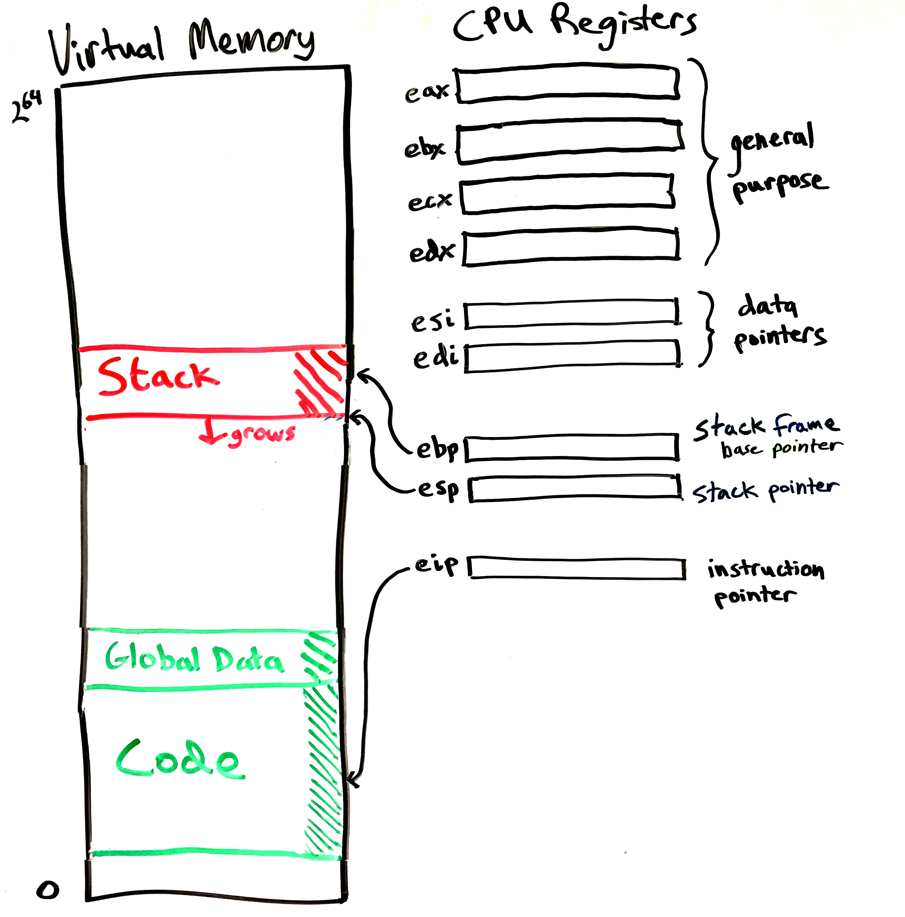
Threads
So far, we have discussed single-threaded processes.
A thread is a part of a process indicating where it’s executing.
OS scheduler actually schedules threads, not processes.

Slide 4
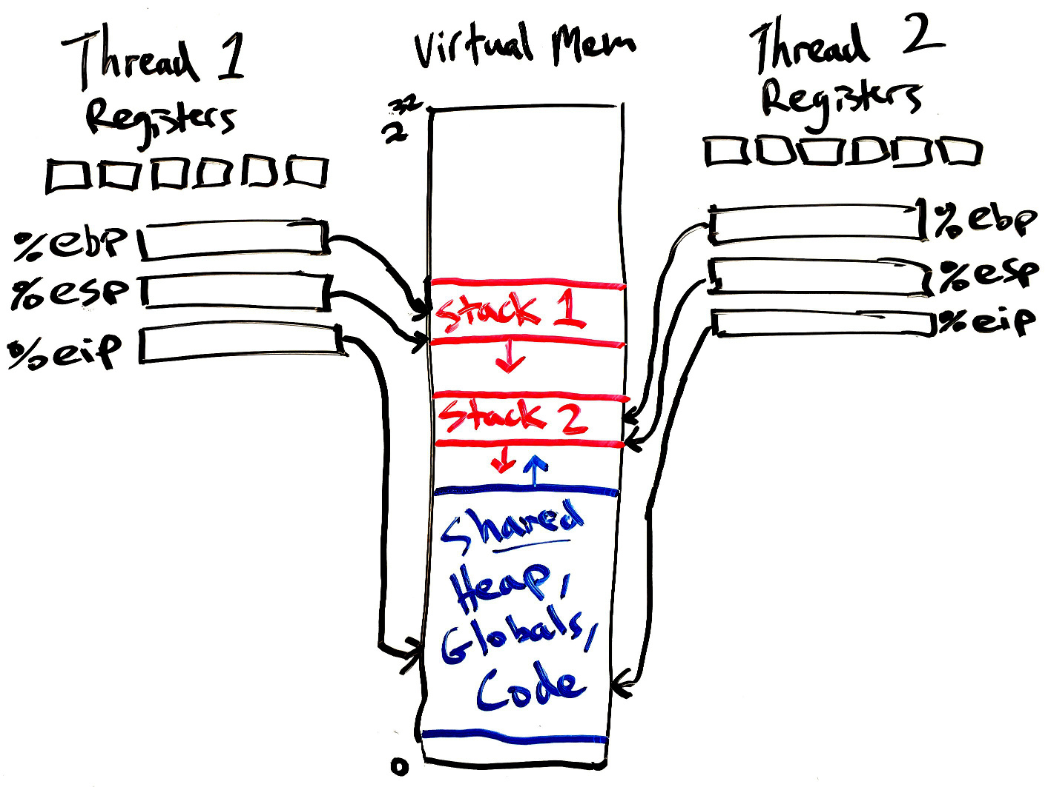
Multi-threaded processes
A multi-threaded process can execute in parallel.
A thread is like a process, but it shares all its virtual memory with all other threads of the same process.
Each thread has:
  Its own set of register values
    (Including the instruction pointer)
  Its own stack

Slide 5
Why use threads?
Allows a process to work in parallel and use multiple CPU cores to get work done faster.
Allows slow tasks to be done in a background thread.
  For example:
    Fetch an image for a website (I/O bound)
    Save a document to disk (I/O bound)
    Transcode a media file (CPU bound)
  This is useful even on machines with a single CPU core.
  For GUI applications, allows main UI thread to be responsive.
    UI thread will use little CPU time and retain high priority in MLFQ.
    Disk/network I/O will not block the UI thread.
Shared memory allows the threads to easily coordinate.
  For example, results can be stored in a global data structure.

Slide 6
Why do we need a stack for each thread?
Remember that the stack stores:
  Local function variables
  Function parameters
  Return addresses
CPU needs a stack to track it’s progress through C-style functions.
Each thread takes its own path through the code.
  So, every thread needs its own stack.
A thread usually should not access another thread’s stack
  The stack is thread local storage.

Slide 7
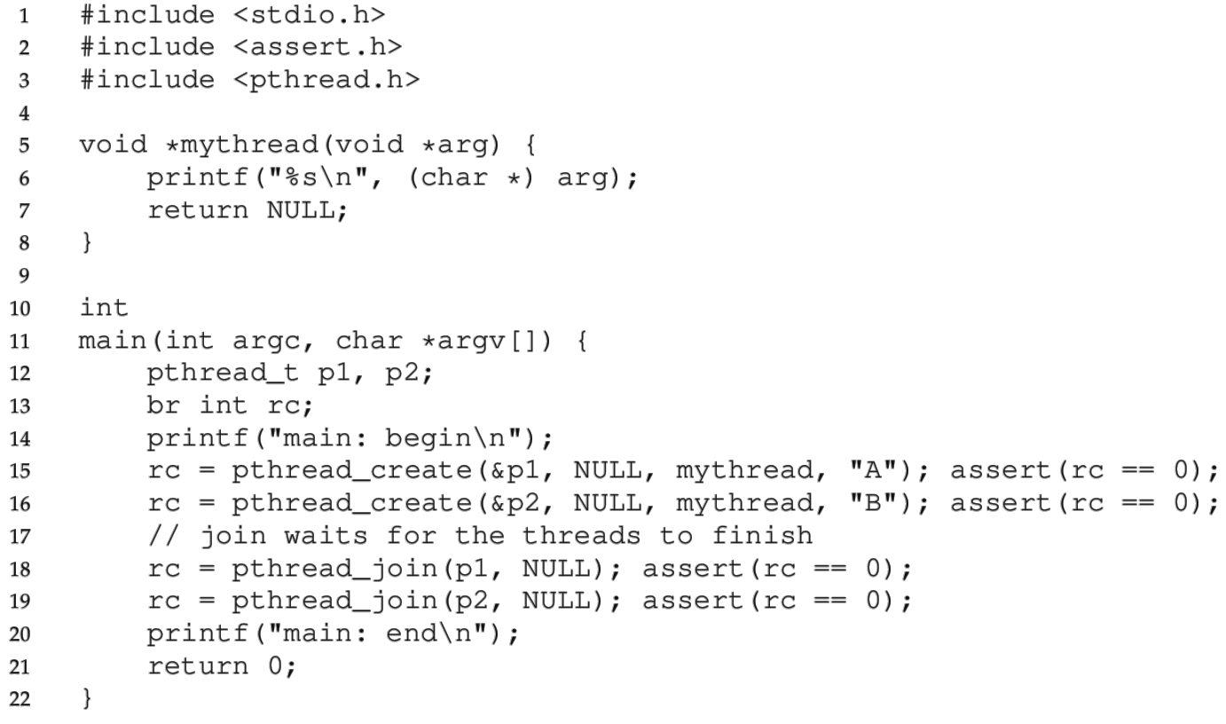
Thread creation example
“pthread” refers to the standard POSIX thread interface.
  POSIX is a set of standards for Unix-style OSes.

Slide 8
Thread creation vs. Fork
Thread creation
Forking a process
pthread_create()
  Creates a thread
  Shares all memory with all threads of the process.
  Scheduled independently of parent
pthread_join()
  Waits for a particular thread to finish
Can communicate by reading/writing (shared) global variables.
fork()
  Creates a single-threaded process
  Copies all memory from parent
    Can be quick using copy-on-write
  Scheduled independently of parent
waitpid()
  Waits for a particular child process to finish
Can communicate by setting up shared memory, pipes, reading/writing files, or using sockets (network).

Slide 9
Concurrency can create tricky problems
#include <stdio.h>
#include <pthread.h>
static volatile int counter = 0;
static const int LOOPS = 1e7;
void* mythread(void* arg) {
printf("%s: begin\n", (char*)arg);
int i;
for (i=0; i<LOOPS; i++) {
counter++;
}
printf("%s: done\n", (char*)arg);
return NULL;
}
int main(int argc, char* argv[]) {
pthread_t p1, p2;
printf("main: begin (counter = %d)\n", counter);
pthread_create(&p1, NULL, mythread, "A");
pthread_create(&p2, NULL, mythread, "B");
// wait for threads to finish
pthread_join(p1, NULL);
pthread_join(p2, NULL);
printf("main: done with both (counter = %d, goal was %d)\n",
counter, 2*LOOPS);
}
Start two threads, each of which increments a shared global counter variable 10⁷ times.
The volatile keyword tells the compiler that the counter variable may change unexpectedly (in this case, changed by the other thread).

Slide 10
Test parallel_count1.c
https://gist.github.com/starzia/b6456d74be2f3ab12a0dd4cbff252717
… or download it from Canvas.
Compile with “gcc -lpthread parallel_count1.c”

Slide 11
What’s the problem?
We have seen with the fork syscall that the scheduler is unpredictable
  We don’t know which of the two threads will run first and for how long.
  But is this a problem?
  Why does it matter who
  increments the counter first?
  The net result should be
  20,000,000 regardless, right?
  Actually, there is a serious bug
  It will yield a different result every time!
You have to understand the low-level behavior to find the problem.
  In short, the “counter++” operation is not atomic.
$ time ./a.out
main: begin (counter = 0)
A: begin
B: begin
A: done
B: done
main: done with both
(counter = 10416197, goal was 20000000)

Slide 12
Incrementing a number in assembly
“counter++” has to:
  Copy from the memory location of the counter variable to a register
  Increment the register’s value
  Copy from the register back to memory
Assuming that “counter” is in memory location 0x8049a1c:
  mov 0x8049a1c, %eax
  add $0x1, %eax
  mov %eax, 0x8049a1c
The scheduler can interrupt the thread before or after the “add”
  This would cause both threads to read the same value, increment it to the same value, and thus they would repeat work.

Slide 13
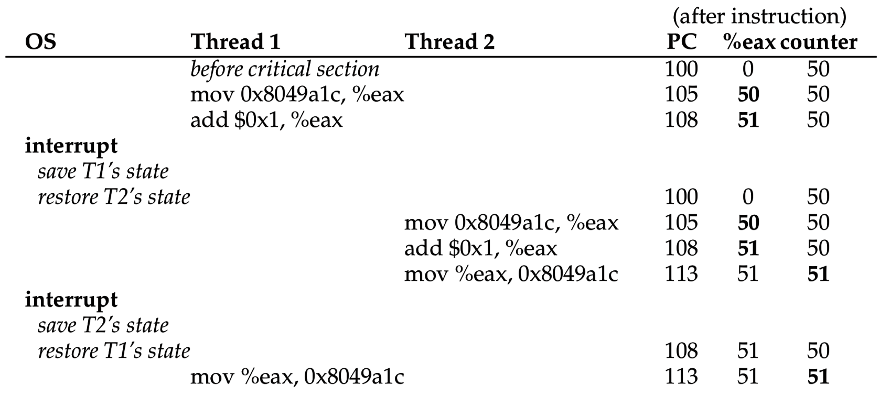
The increment failure in detail: 50 + 1 + 1 = 51!
XX

Slide 14
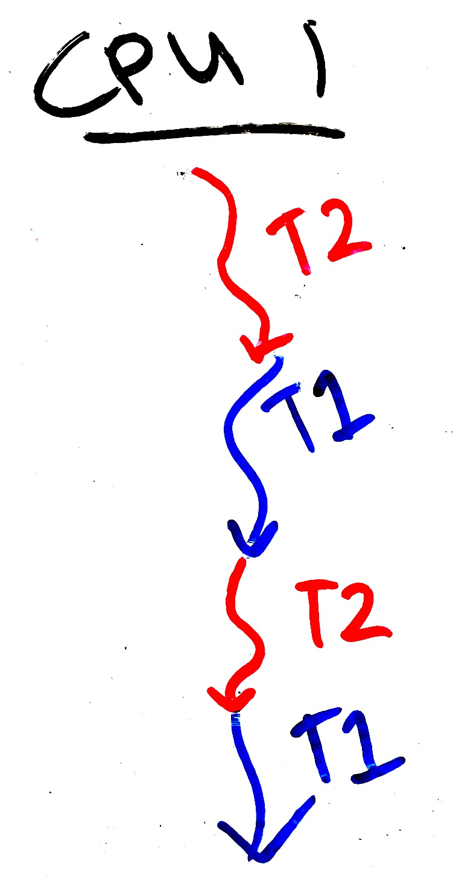
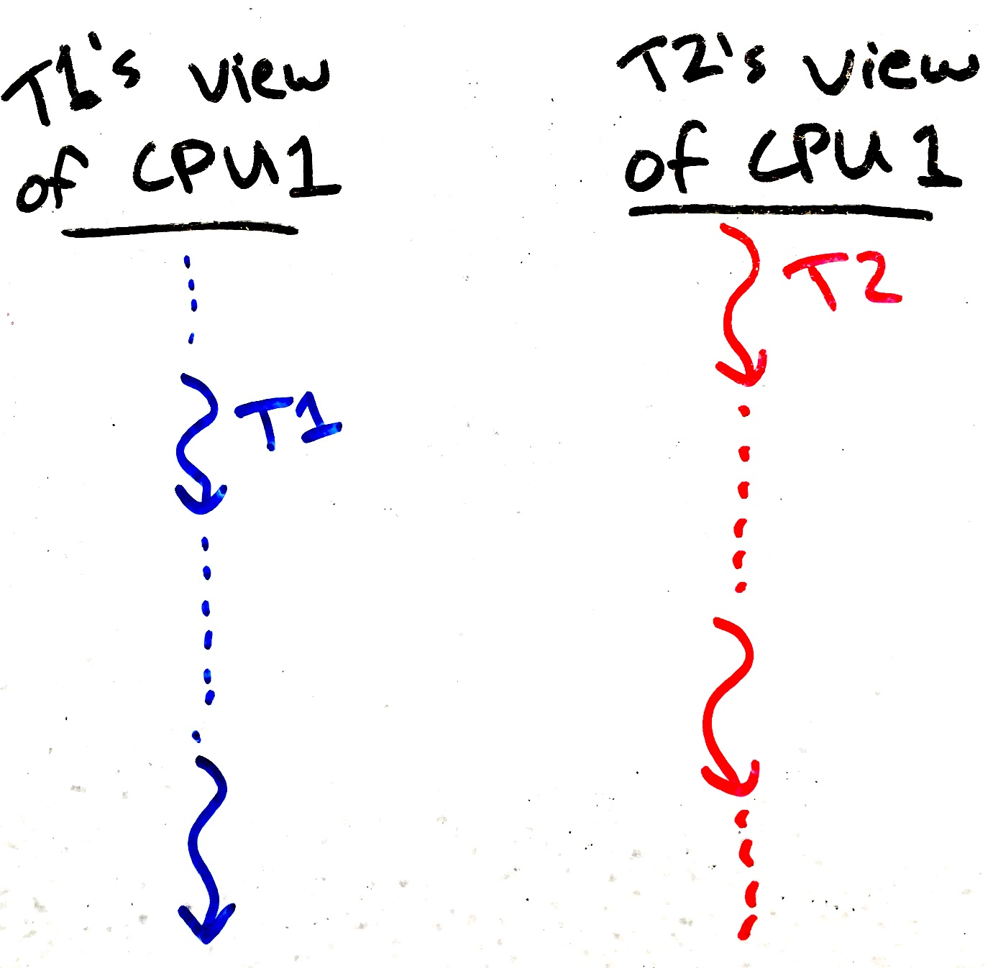
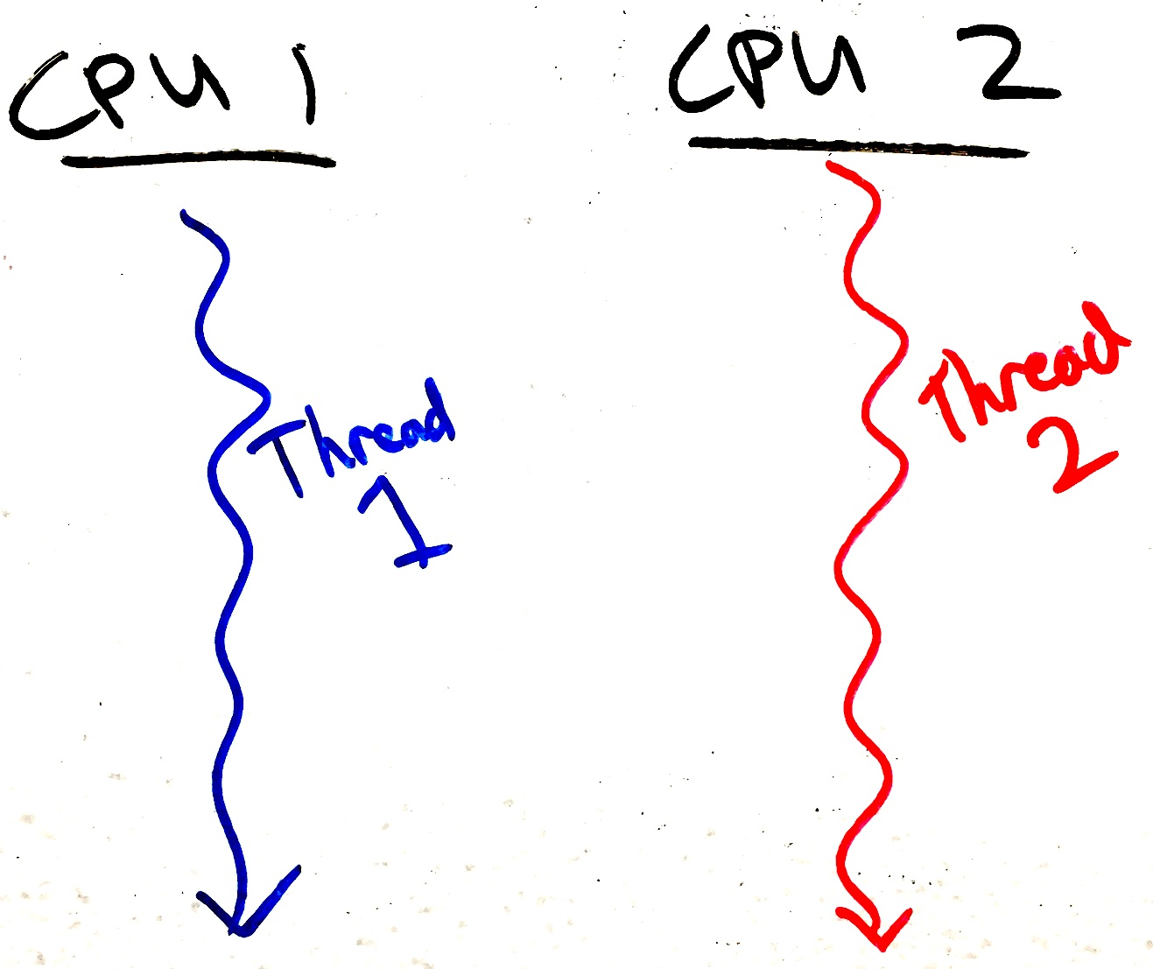
The process scheduler creates concurrency
Even if only one CPU is present, threads operate “concurrently” because they are taking turns using the CPU.
Each process thinks it has its own CPU that is sometimes very, very slow…
Obvious concurrency on two CPU cores:
Simulated concurrency on one CPU core:
Slow
Is like
Slow time
Slow time
Slow time

Slide 15

Assume the scheduler is evil
Remember that processes have no control over the scheduler.
So, to protect against concurrency bugs, we must assume that the scheduler can interrupt us at any time and schedule any other process.
In other words, assume that the scheduler is adversarial, and will do the worst possible scheduling.
To prevent weird and rare concurrency bugs,
your code should work correctly even when
faced with an evil scheduler.

Slide 16

Intermission

Slide 17
Terminology
Race condition:
  Two or more things are happening at the same time,
  it’s not clear which will finish first, and
  the result will be different depending on which finishes first.
Indeterminate: Output can be different each time (not deterministic).
Critical section:
  Code that accesses a shared resource and must not be executed concurrently.
  In other words, code that would lead to a race condition.
  Sometimes called a transaction, especially in database systems.
  We must execute critical sections atomically, meaning that it cannot be partially executed. Atomic means it cannot be divided, or is executed “all or none.”
Mutual exclusion primitives are used to protect critical sections.
Locks are the simplest kind of mutual exclusion primitive.

Slide 18
Critical sections
Critical sections often involve modification of multiple related data
  While the modifications are happening there is some inconsistency
  The inconsistency is eventually resolved before leaving the critical section
For example:
  Inserting an element in the middle of a linked list
    Two pointers must change. List is broken if just one is changed.
  Swapping two values.
Don’t have to worry about critical sections if:
  Operation is just one assembly instruction (CPU executes these atomically), or
  Program is single-threaded or the particular data is not shared among threads

Slide 19
Buggy concurrent swap
#include <stdio.h>
#include <pthread.h>
static volatile char* person1;
static volatile char* person2;
static const int LOOPS = 1e4;
void* mythread(void* arg) {
printf("%s: begin\n", (char*)arg);
int i;
for (i=0; i<LOOPS; i++) {
// swap
volatile char* tmp = person1;
person1 = person2;
person2 = tmp;
}
printf("%s: done\n", (char*)arg);
return NULL;
}
int main(int argc, char* argv[]) {
pthread_t p1, p2;
person1 = "Jack";
person2 = "Jill";
printf("main: begin (%s, %s)\n",
person1, person2);
pthread_create(&p1, NULL, mythread, "A");
pthread_create(&p2, NULL, mythread, "B");
// wait for threads to finish
pthread_join(p1, NULL);
pthread_join(p2, NULL);
printf("main: end (%s, %s)\n",
person1, person2);
}
https://gist.github.com/starzia/3cfd83f736b54cae1eb856561eb5e576

Slide 20
Critical sections in xv6: process table in kernel/proc.c
Why do we worry about critical sections in the kernel?
  An OS kernel on a multi-core machine is like a multi-threaded process, so we must protect the kernel’s critical sections.
  A hardware interrupt can happen at any time and prempt the kernel
Process table is a shared resource
Proc structs have many fields
Don’t want to read a proc struct that is just partially filled-in
Don’t want to accidentally assign the same “next” pid to two processes
Etc.

Slide 21
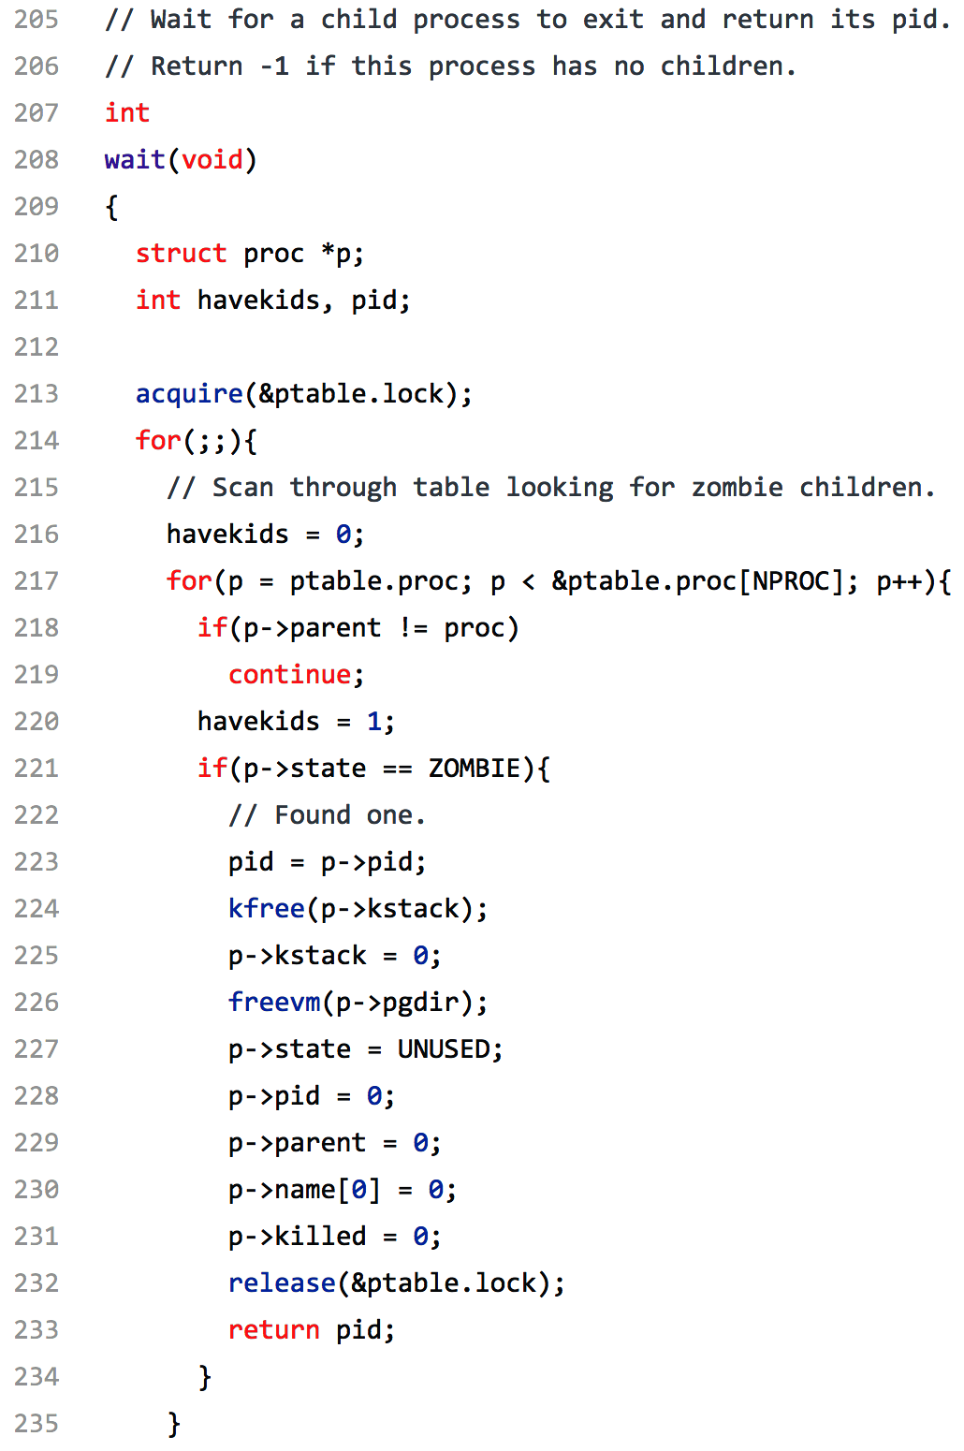
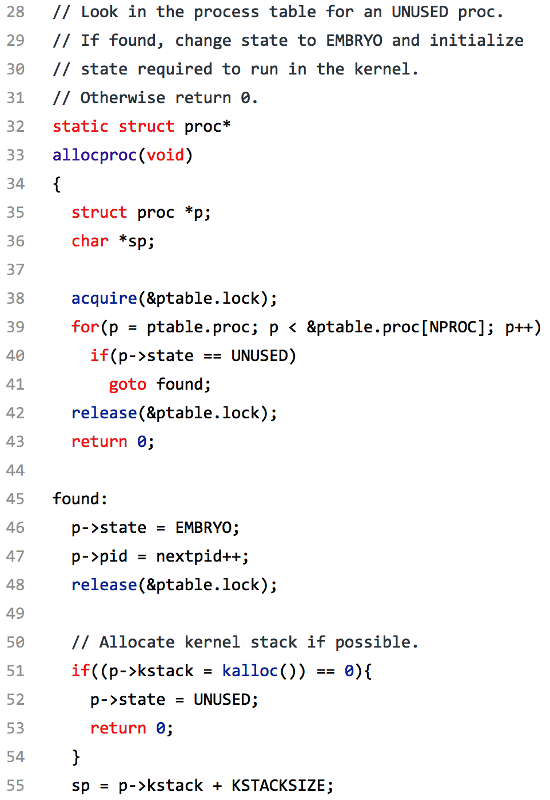
Critical Sections

Slide 22
Critical sections in Project 2
Most importantly, when deciding whether to deallocate a shared page
If two processes sharing the page are killed concurrently then:
  Both processes might think the other is still using the page and neither would free it.
  Both processes might think they are the last to use the page and both would try to free it.
Depending on your implementation you may or may not need a lock
The lock on the process table may already protect your critical section.
Project 3 also has shared memory, and this time you must protect critical sections.

Slide 23
Locks
Locks are the simplest mutual exclusion primitive
  Represent a resource that can be reserved and freed
Has two main functions:
Acquire/lock:
  Used before a critical section to reserve the resource
  If the lock is free (unlocked), then lock it and proceed.
  If the lock is already taken (someone else called acquire/lock),
  then wait until it’s free before proceeding.
Release/unlock:
  Used at the end of a critical section to free the resource
  Allows one waiting (or future) thread to acquire the lock

Slide 24


Two different metaphors & etymology
Lock
Token
A lock is something that’s
designed to block access.
Our virtual lock works as follows:
  Anyone can lock or unlock
  (there is no “key”).
  Trying to lock an already-locked lock will cause you to wait until it’s unlocked.
The “lock” is actually a poor/confusing metaphor.
Holding the token gives
you permission to do something.
There is only one token.
Thus, you:
  Try to acquire the token (“lock”). You have to wait your turn if someone else is holding it.
  When done, release the token/lock.
The token represents exclusive access to a shared resource or a critical section.

Slide 25
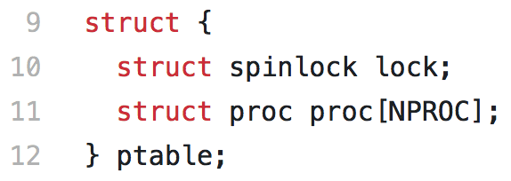
Spinlock in xv6
struct spinlock stores the state of the lock (whether or not it’s acquired).
initlock() initializes it (just once)
acquire() proceeds if the lock is not already acquired.
  Must atomically check and set a value in the struct spinlock. (details next lecture)
  If lock is already acquired, it waits until thread releases it.
release() lets another thread acquire the lock later.
  Must remember to release the lock!

Slide 26
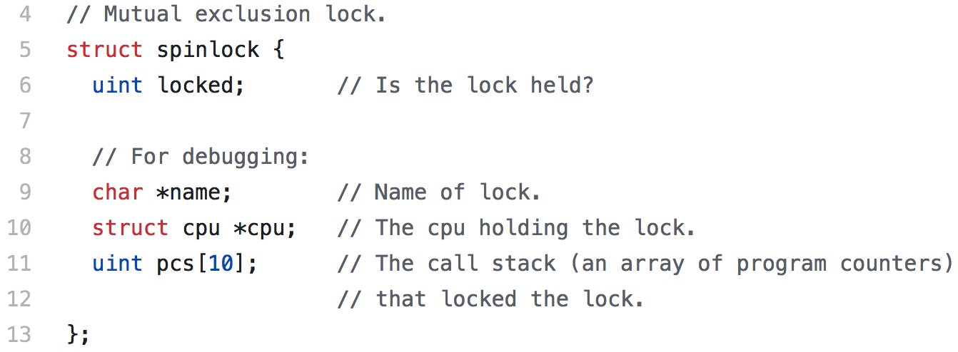
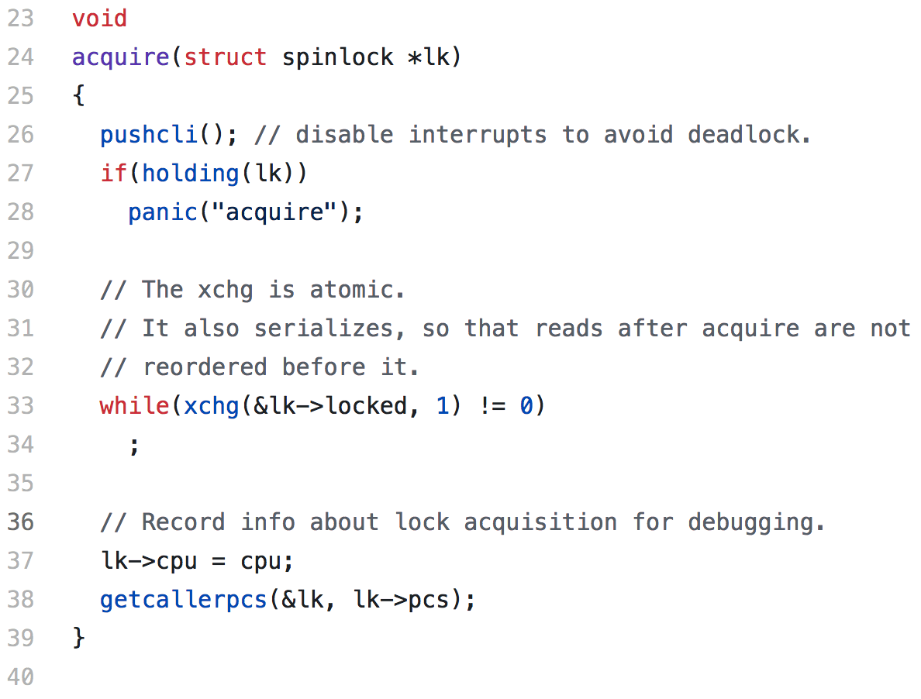
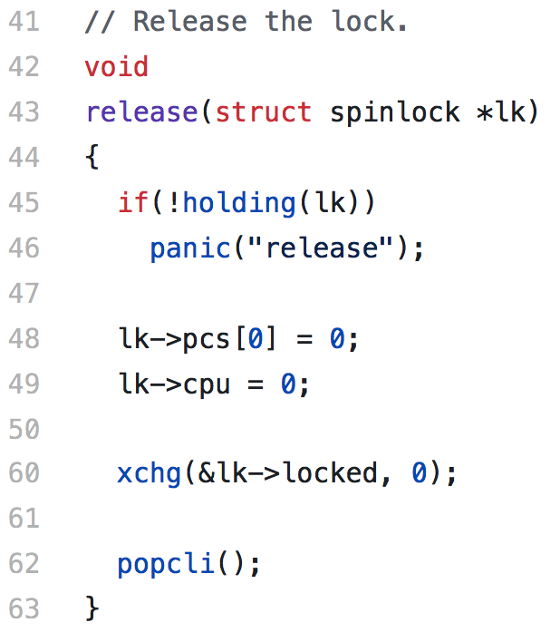
xv6’s spinlock.[ch]

Slide 27
Recap
Processes can have multiple threads sharing the virtual address space
Critical sections are block of code that must be run atomically
If unprotected, critical sections lead to race conditions that make code indeterminant – we get different results depending on timing.
Locks are the simplest mutual exclusion primitive, with two main functions:
  Acquire/lock – get exclusive access to a shared resource.
  Release/unlock – release the shared resource.
Concurrency occurs naturally in multi-CPU systems
Concurrency is created by the process scheduler in single-CPU systems
Next time: how locks and other synchronization primitives are built!

