Slide 1

EECS-343 Operating Systems
Lecture 18:
Log-structured File Systems
Steve Tarzia
Winter 2018
Diagrams taken from “Three Easy Pieces” book

Slide 2
Announcements
Project 4 is due on Wednesday.
HW4 due on Friday
Final exam is this coming Monday, June 10th, 3-5pm
  Final will be cumulative
  There will be some code-reading questions
  More questions will be objective, and fewer will be “essays.”
  Open book, open notes
  No passing notes or books during the exam

Slide 3
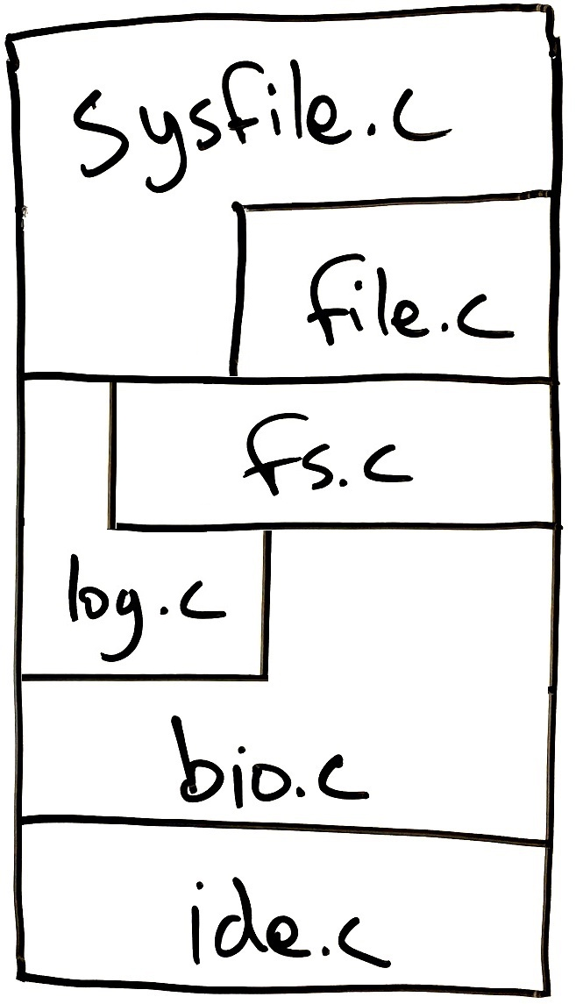
Last Lecture – Storage Layer Interactions
Showed layered design of xv6 storage system
Implementation of each layer uses only the layer(s) directly below
  Must provide an API suitable for implementing the layer(s) directly above
  Deeper layer are hidden.
defs.h makes a subset of kernel functions in each file “public.”
Linux has a virtual file system (VFS) layer that allows multiple filesystems to coexist in one machine.

Slide 4
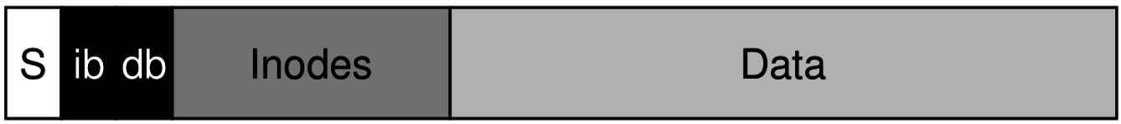
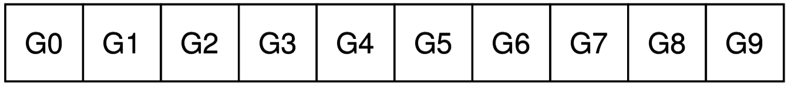
Fast File System reduces seek times
Recall that a read/write accesses four or more disk blocks
  In classic Unix/xv6 FS, long seeks are needed to move between inodes and data blocks:
Fast File System and its descendants, like ext2 & ext3, divide the disk into block groups, each arranged like a miniature filesystem:
  If possible, put a file’s inode and its data blocks (and parent and siblings) in the same block group. This is locality again – putting related things nearby.

Slide 5
Throughput problems in traditional filesystems
Usually we think of a disk abstractly as an array of data sectors.
But sequential reads/write are much faster than random accesses.
  xv6 FS is ignorant of this. It just implements a buffer cache layer to reduce repeated disk I/Os to the same locations.
Caching does not help if you need to write lots of new data.
If writing one big file, we can get a large sequence of contiguous data blocks.
But, if writing many small files, good performance is very difficult to achieve.
  FFS block groups reduce seek length. ✅
  Delaying and batching requests allows the disk firmware to reorder them. ✅
  But we are still doing a lot of seeks. 😔

Slide 6
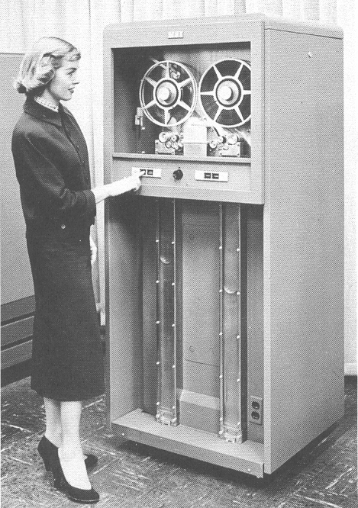
Log-structured Filesystems (LFS)
Tape drive circa 1953:
A radically different filesystem design.
  How would you design a filesystem for:
    A tape drive, with very, very slow seek times?
      ~one minute to rewind through the entire tape
      500 inches/second. 1500-3000 foot tape reel.
    A pen and paper notebook?
Try to do every write sequentially. But how?
Idea is to treat the filesystem like a log.
  A log is a sequence of events, new ones at the end.
When data changes, don’t bother going back to edit the original, just store new copy at the end.
  In the simplest case, assume infinite capacity.
http://www.columbia.edu/cu/computinghistory/701-tape.html

Slide 7
LFS is optimized for write performance
Traditional filesystems access many different parts of disk during reads and writes, but buffer cache is meant to fix this problem.
  However, caching only helps with repeated access to the same disk block.
It turns out in real-world workloads:
  Reads of the same location are often repeated, but…
  Disk space is cheap, so programs often write lots of data, even if most is never used again.
Caching helps with #1 but not with #2.

Slide 8
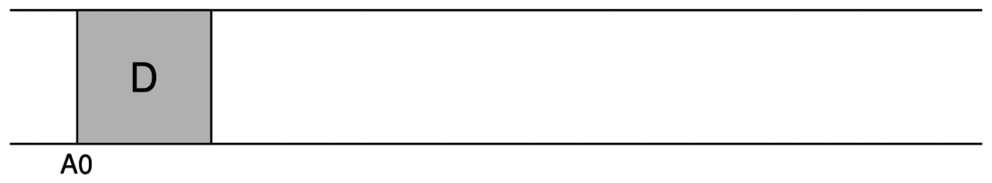
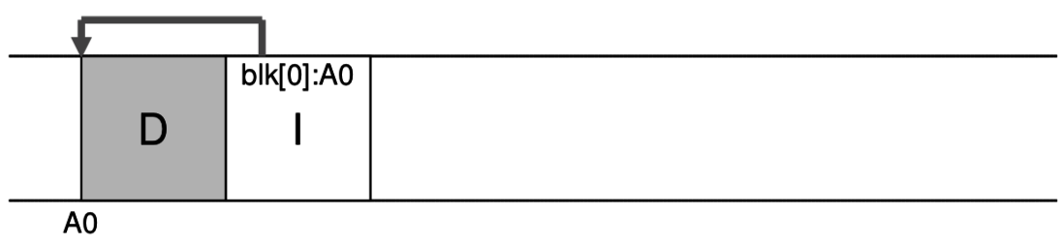
Just keep writing to the end, sequentially
LFS still has inodes and data blocks, it just places them differently.
Always write to the end. For example, when writing a small file:
  Write data block:
  Then write the inode:

Slide 9
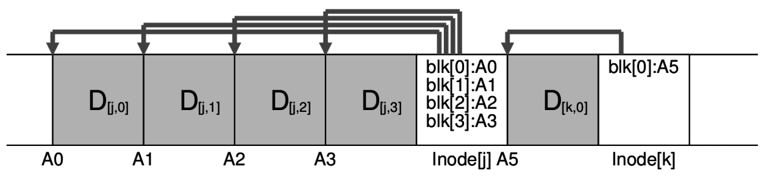
Write two files
As always, we write the data blocks before inodes to minimize the impact of an interruption/crash.
Note: this picture assumes that we open the file and write a large chunk of data all in one big operation.
This can be achieved by delaying the writes to disk with a buffering/caching layer.

Slide 10
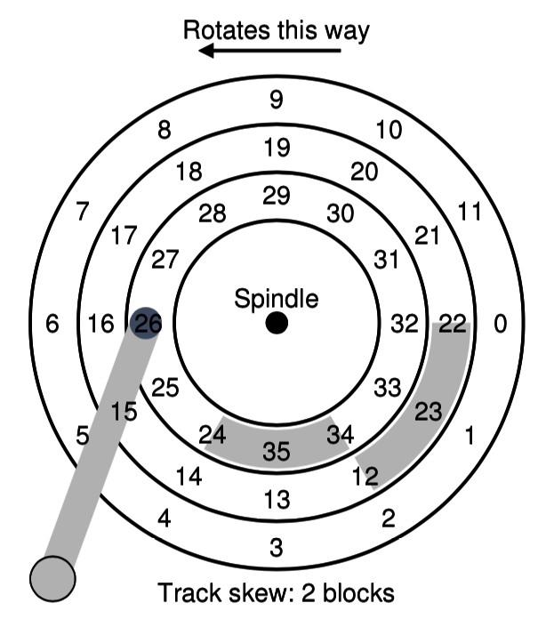
Writing in large segments reduces rotational delays
Even though we are writing to sequentially increasing locations, there is still the possibility of a long rotation delay if the requests are not issued together.
  For example, writing sectors 27, 28, 29 can be very fast in the best case, but only if we are ready to write 28 immediately after 27.
  A small delay between write(27) and write(28) might make us to wait for a full disk rotation.
So, LFS buffers writes and sends them in large batches (few MB) called segments.
  Goal is to balance rotation & seek delay with segment data transfer time.

Slide 11
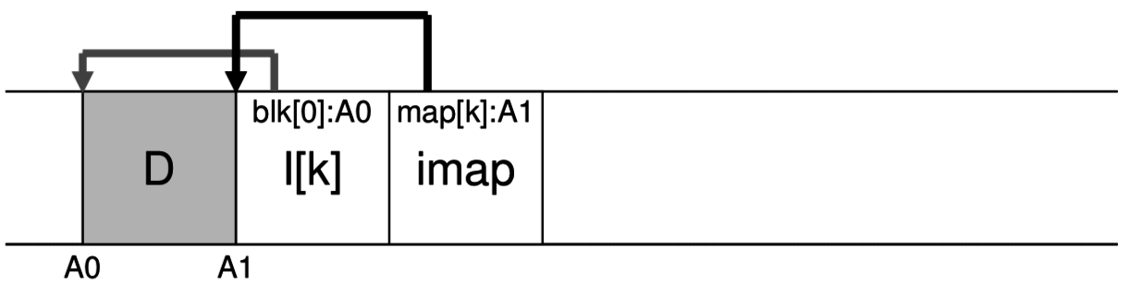
Inode map tracks inodes within a segment
Formerly, inode numbers could be used to find inode struct in an array.
LFS makes it more difficult to find inodes. They are placed in arbitrary locations on disk. Now how do we find a particular inode?
Each segment has an inode map giving address of each of its inodes.
Recall that segments are large, and can contain hundreds of inodes.
But this is not a complete solution, because there are many segments and many inode maps, themselves in random locations on disk.

Slide 12
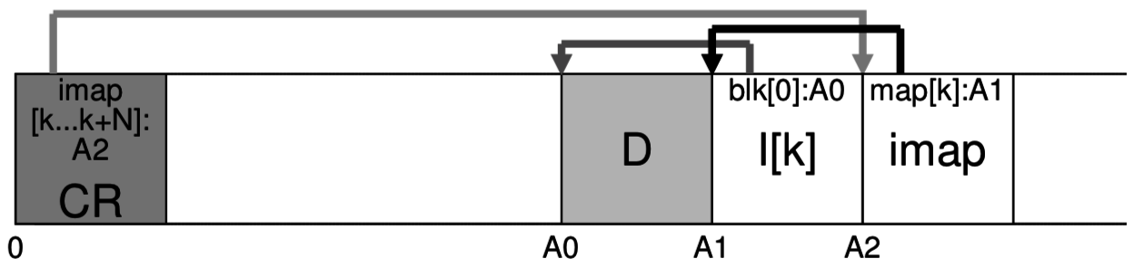
Two levels of indirection to find inodes
At the beginning of the disk, store a checkpoint region, which just points to all the valid inode maps on disk:
The i-map is distributed throughout the disk in all the valid segments.
  Finding an inode involves looking at the entire imap. This could be slow, but in practice we should be able to keep then entire ipap cached in memory.
  Checkpoint region keeps a persistent record of the distributed imap.
Infrequently (~30 seconds), seek to the beginning of the disk to flush the in-memory cache of the checkpoint region.
List of imaps:
[A2, …]

Slide 13
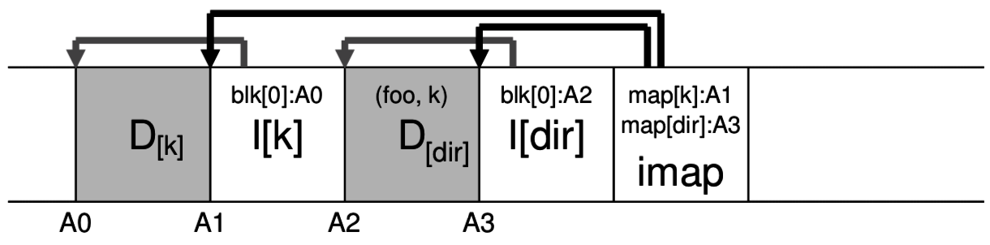
A segment with a file and a directory
Directories are also stored in the same way:
Notice that the directory lists the <filename, inode#>, as usual.
This inode # does not tell us where to find the file inode.
  Must check the in-memory inode map to find the associated disk block.
  At boot time, read the checkpoint region and the distributed inode map.

Slide 14
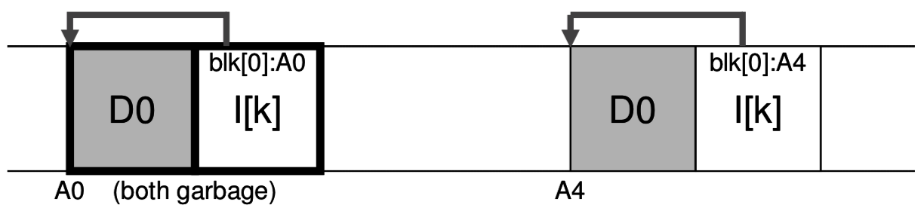
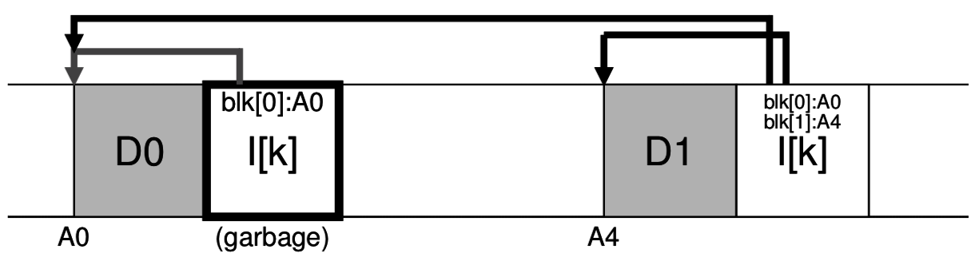
Never go back to modify existing data
Always write a new copy of the entire block. If editing data:
If appending data to a file, the inode is edited:
Old version
New version
…

Slide 15
Pointing to the new version (after file edit)
Old segment
New segment
map[k]:A1
…
Imap
(old)
41
map[k]:A42
…
Imap
(new)
CR
(points to all valid imaps)
…
…
…
…
41
Old data still exists on the disk, but the in-memory i-map and its persistent copy in the checkpoint region do not refer to it.
If we disk space is infinite, that’s good enough.
If we save an old version of the checkpoint region, it can be used to view and old snapshot of the filesystem!
  A filesystem that preserves old snapshots is a versioning file system.

Slide 16
Rewriting inode maps
Old segment
New segment
CR
(points to all valid imaps)
…
inodes & data blocks
Imap
(old)
…
inodes & data blocks
Imap
(new)
A segment holds many inodes, declared in one i-map.
  Checkpoint region points to i-maps that must be entirely valid
So, when editing a file, not only must the file be rewritten (the data block(s) and inode), but the segment’s i-map must be rewritten.

Slide 17
Intermission
Show previous slide

Slide 18
Pen and paper example
Appending to a file

Slide 19
Disks actually have finite size
Cannot write sequentially forever
Cannot keep old versions of data around indefinitely
Eventually need to garbage collect segments with free space
  Actually, we want to free full-sized segments.
  If we encounter a segment that is partially filled, then free the full segment and rewrite a compacted version of the segment at the end of the log.
After reaching the end of the disk, restart the writing at the beginning of the disk, but only write to the “holes” left by the garbage collector.
Garbage collector periodically scans through the disk, perhaps during idle time.
  But how can GC decide whether which blocks are live or dead?

Slide 20
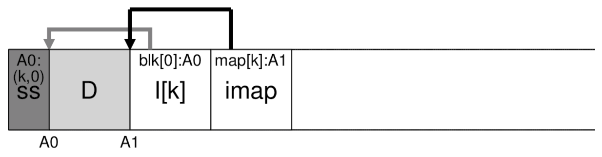
Backward pointers aid garbage collection
The distributed i-map tells us directly whether an inode is live or dead.
Data blocks are more difficult to classify
  Naïve approach is to examine every inode on the disk, looking for a reference to the block; but this is way too slow.
  We want some kind of backward reference from data block to inode.
Solution: add a segment summary block indicating the inode number and block offset for each data block in the segment.
  Check whether inode listed in SSB still refers to the data block.

Slide 21
Final LFS notes
The main idea of a log-structured filesystem is also called copy on write and shadow paging (in DBs).
    This is different than “copy on write” of process memory when forking.
    However that other kind of CoW can also be implemented for file copies.
ZFS, Btrfs, and new Apple FS are log-structures filesystems.
Also used in Linux LiveCDs to make a read-only disk appear writeable (as long as you have enough space in RAM for the writes).
How to make LFS reads fast?
  Writes are naturally sequential, but reads can involve lots of seeks.
  As always, batch them together so they can be reordered to minimize seeks.

Slide 22
Data integrity
With trillions of bits stored on a disk, it’s very possible that one will be flipped due to a hardware malfunction, radiation, etc. (“bit rot”)
Checksum is a standard way to detect data corruption:
  It’s a mathematical function that produces a small summary of the data
    Different checksum functions can be used: CRC, MD5, SHA1
  Result has fixed length, but input can be of arbitrarily-large size
  It’s essentially a hash function: same input always gives same output.
  Cannot be perfect, due to pidgeonhole principle
    Sometime two different inputs will produce the same output, so not all errors are detectable.
Store data or metadata checksums in a filesystem to detect corruptions.
  ZFS and Btrfs do this.

Slide 23
Networked File Systems
These are used:
  When users must access their documents from multiple machines.
  In huge systems, specialized server hardware is dedicated to storage and different hardware is used for computing tasks.
Networked filesystem can be served by one machine,
Or, for “big data” problems, multiple machines can be clustered to form a distributed/parallel filesystem.
Machines in the Wilkinson Lab and T-Lab mount home directories through NFS, a Unix protocol for networked file systems.
  Windows has something similar, called SMB/CIFS.
Quest supercomputer at NU has a 3.5PB GPFS parallel filesystem.

Slide 24
Why move storage further away?
Surely, networking adds some latency and complexity.
But:
Modern networks are fast.
It’s faster to access a neighbor’s RAM than to access your own disk!
Fault tolerance requires an array of disks (eg., RAID5) which may not fit in your client machine.
Can manage backups centrally, rather than relying on client users/HW.
Pooling storage leads to less wasted space.
Can deduplicate shared data.
Allows access of same data from multiple devices. Etc., etc., …

Slide 25
Recap - Log-structured File System
Tries to make all writes sequential, at the end of the disk (at first).
Never edit data blocks or inodes, just write new copies and stop referring to the old versions. Inodes are scattered throughout the disk.
Checkpoint region points to distributed inode map, to find inodes.
  CR is the only thing that is always written in a well-known location.
  Using an old version of the checkpoint region lets us see the filesystem as it looked in the past. LFS can be extended easily to become a versioned file system.
Garbage collector occasionally scans FS to compact segments with old, unused versions of blocks.
Restart from start of disk after reaching the end, filling in holes.

